Slide 1

Custom Fields:
An Introduction
Part 1 – Introduction to Custom Fields
Notes:
Waters Confidential and Proprietary Information

Slide 2

Content
What is a Custom Field
Creating a New Custom Field
  Custom Field Types
  Data Types
  Entering Formulas
Custom Fields Creation Examples
  Sample
  Sample Set
  Component
  Peak
  Result
  Using CCompRef1, CConst1
Notes:
Content
In this chapter you will learn about the different types of custom fields and how to create basic custom fields.

Slide 3

Understanding Custom Fields
Understanding custom fields is like understanding a programming language
  There is no recipe book for what you can develop
  There are usually multiple ways to develop specific calculations
  Practice is the only way to learn
  Try and see what happens
  Learn from and discuss with others

Slide 4

What is a Custom Field?
A field is a column of information in a table.
A custom field is a user-defined field in a table.
Custom fields can be descriptors and formulas.
Notes:
What is a Custom Field
A field in Empower terms is a field in the underlying Oracle database. It will show up as a column in various tables in Empower.
A large amount of fields are embedded in the database as standard, like Sample Name, Peak Retention Time or Peak Area.
You can create new fields called Custom Fields to customize Empower to track, manage, and calculate information about results, samples, and chromatographic applications beyond what is already provided.

Slide 5

Why Use a Custom Field?
To store information about samples in the Empower database.
To report information about your sample in an Empower report.
To sort data by custom sample information.
To set Empower to perform automated calculations.
Sample Description Identifiers
Custom Database Results Calculations
Notes:
Why use Custom Fields
There can be numerous reasons why you would want to create and use custom fields. The most important are:
If you want more information about you samples stored in the database.
To report information about your samples in a report.
To use the custom fields to sort or search for information.
To set Empower to do calculations that are not performed as standard in Empower.

Slide 6

Custom Fields
Custom fields are created in a Project.
To create a custom field, you need the Alter Any Project and the Create Custom Fields privileges
These privileges are specific to custom fields:
  Create CF
  Alter CF
  Delete CF
  Lock CF
  Unlock CF
You can include custom fields in view filters, views and reports.
Notes:
Location of Custom Fields
Custom Fields reside in a project.
To create a custom field a user needs the Alter Any Project and Create Custom Field privilege.
There are 5 specific privileges associated with Custom Fields:
Create Custom Field
Alter Custom Field
Delete Custom Field
Lock Custom Field
Unlock Custom Field
You can view custom fields in the various tables in the project and also include them in reports.

Slide 7

Creating Custom Fields
Plan your custom fields on paper
Work in a test project
Ensure the custom field performs as expected
Copy your custom field to other projects after you
verify its usability
Do not blindly copy all custom fields to all projects
Notes:
Creating Custom Fields
The best way to create custom fields is to first plan it on
paper. If it is a calculation write down the formula.
Then create the custom field in a test project and then
test/validate that it performs as expected.
Copy the custom filed to the project where it will be used.
Do not blindly copy all your custom fields to all projects, since all custom fields in a project will be calculated each time you process a sample. If for some reason a custom field can not be calculated because some part of the formula does not exist in a particular project an error message will be produced.

Slide 8
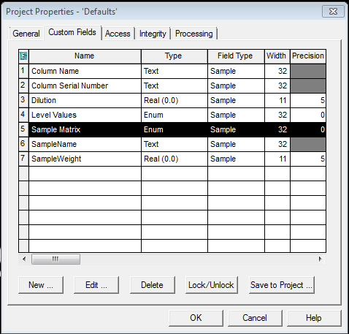
Default Custom Fields
There are 7 Default Custom Fields in Empower 3
Found in the Default Project
All are Sample Field Type:
  Column Name
  Column Serial Number
  Dilution
  Level Values
  Sample Matrix
  Sample Name
  Sample Weight
Notes:
Default Custom Fields
The reason that these 7 are created as Default Custom Fields is that they can then be edited. You can change the width of these fields if you for example want more than 32 characters for the Sample Name.
For the Enumerated types you can add, edit or delete the default entries in the translation table.

Slide 9
Creating a New Custom Field
What is it? Why use it?
Create:
Field Types
Create:
Data Types
CF Examples
Create:
Others

Slide 10
Creating a New Custom Field
What Type of Field to Create?
What is it? Why use it?
Create:
Field Types
Create:
Data Types
CF Examples
Create:
Others

Slide 11
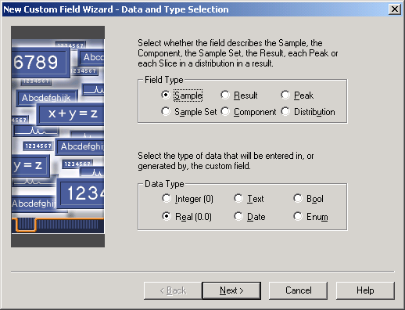
What Type of Field to Create?
Notes:
Field Type
The screen shown above is the first part of the New Custom Field wizard. The first thing you need to consider is what type of field you want to create.

Slide 12
Types of Custom Fields
Sample: Descriptive, if numerical. Can be used in calculations
Sample Set: Descriptive, relates to a complete sample set
Component: Relates to each component in the component editor
Peak: Relates to each peak in the chromatogram
Result: Relates to a result for an entire sample
Distribution: For GPC option only
Notes:
Types of Custom Fields
There are six types of custom fields in Empower:
Sample – Identifier of a sample, used where information is different for each sample.
Sample Set – Identifier of an entire sample set and not specific parameters.
Component – Identifier that pertains to a particular component in the sample as identified in the component table of the processing method.
Peak – Custom calculation of a peak-level parameter, including an interpeak calculation capability (for example, Area[Ratio] = Area/Peak1[Area]).
Result – Custom calculation of a result-level parameter (for example, the total area of all peaks with a %Area less than 2% = Sum(Area*LTE(%Area,2.0)).
Distribution – Custom calculation of a distribution slice-level parameter for GPC/V data.

Slide 13
Field Type: Sample
Describes samples, vials, and sample parameters.
Used when the information is different for each sample
Entered in:
  Samples table of the Run Samples window
  Alter Sample window
Supported Data Types:
  Integer
  Real
  Text
  Date
  Boolean
  Enumerated
Notes:
Examples of Sample Type Fields:
Where else can you find Sample Type Fields?
Review's Chromatogram Result table and Channels tab
The Project Window in
Injections
Channels
Results
Peaks
Sign Offs
Custom Fields

Slide 14
Sample: Custom Field Type
What it does | What it can contain (Examples) | Where it appears
Describes samples, vials, custom samples, and sample parameters | Lot number Analyst's name Patient ID Dissolution medium Storage interval Storage conditions Plant number Manufacture date | Samples table of the Run Samples window Alter Sample window Sample Set Method Editor Review's Chromatogram Result table and Channels tab New Custom Field editor Report Publisher These tabs of the Project window: Injections Channels Results Peaks Sign Offs Custom Fields
?
Notes:
Sample Type CF
Examples of Sample Type custom fields are shown above.
Custom fields such as these could all be tracked as a Sample Type custom field and, like SampleName, the field would appear in the Run Sample’s Sample tab, allowing the user to enter appropriate information. After data is acquired, this information is displayed in the Alter Sample window where it can be modified, if necessary. The field can also be added to the project window’s Injections, Channesl, Results, Peaks, sign Offs and Custom Fields views and can be printed in a customized report.

Slide 15
Sample: Custom Field Type
What it does | What it can contain (Examples) | Where it appears
Describes samples, vials, custom samples, and sample parameters | Lot number Analyst's name Patient ID Dissolution medium Storage interval Storage conditions Plant number Manufacture date | Samples table of the Run Samples window Alter Sample window Sample Set Method Editor Review's Chromatogram Result table and Channels tab New Custom Field editor Report Publisher These tabs of the Project window: Injections Channels Results Peaks Sign Offs Custom Fields
Notes:
Sample Type CF
Examples of Sample Type custom fields are shown above.
Custom fields such as these could all be tracked as a Sample Type custom field and, like SampleName, the field would appear in the Run Sample’s Sample tab, allowing the user to enter appropriate information. After data is acquired, this information is displayed in the Alter Sample window where it can be modified, if necessary. The field can also be added to the project window’s Injections, Channesl, Results, Peaks, sign Offs and Custom Fields views and can be printed in a customized report.

Slide 16
Field Type: Sample Set
Identifies a Sample Set. Used when the information is the same for the entire set of data.
Entered in Sample Set Information:
  Run Samples window
  Alter Sample window
Supported Data Types:
  Integer
  Real
  Text
  Date
  Boolean
  Enumerated
Notes:
Examples of Sample Set Type Fields:
Where else can you find Sample Set Type Fields?
Sample Set Method Editor
The Project Window in
Sample Sets
Injections
Channels
Result Sets
Results
Peaks
Sign Offs
Custom Fields

Slide 17
Sample Set: Custom Field Type
What it does | What it can contain (Examples) | Where it appears
Identifies a sample set | To identify a protocol run's SOP Batch number Mobile phase | Sample Set Information dialog in Run Samples window Sample Set Information dialog in Alter Sample window Sample Set Information dialog in Sample Set Method editor These tabs of the Project window: Sample Set Injections Channels Result Sets Results Peaks Sign Offs Custom Fields
?
Notes:
Sample Set Type CF
Examples of Sample Set Type custom fields are shown above.
Custom fields such as these are entered in the Sample Set Information dialog, in the Run Samples window allowing the user to enter appropriate information. After data is acquired, this information is displayed in the Alter Sample window where it can be modified, if necessary. The field can also be added to the project window’s Sample Set, Injections, Channels, Result Sets, Results, Peaks, Sign Offs and Custom Fields views and can be printed in a customized report.

Slide 18
Sample Set: Custom Field Type
What it does | What it can contain (Examples) | Where it appears
Identifies a sample set | To identify a protocol run's SOP Batch number Mobile phase | Sample Set Information dialog in Run Samples window Sample Set Information dialog in Alter Sample window Sample Set Information dialog in Sample Set Method editor These tabs of the Project window: Sample Set Injections Channels Result Sets Results Peaks Sign Offs Custom Fields
Notes:
Sample Set Type CF
Examples of Sample Set Type custom fields are shown above.
Custom fields such as these are entered in the Sample Set Information dialog, in the Run Samples window allowing the user to enter appropriate information. After data is acquired, this information is displayed in the Alter Sample window where it can be modified, if necessary. The field can also be added to the project window’s Sample Set, Injections, Channels, Result Sets, Results, Peaks, Sign Offs and Custom Fields views and can be printed in a customized report.

Slide 19
Field Type: Peak
User-defined mathematical calculation pertaining to a peak.
Fields within a peak:
Area/Amount
Fields between peaks:
  Peak Name A[Area]/Peak Name B[Area]
Found in any Peaks table. Supported Data Types:
  Integer
  Real
  Text
  Date
  Boolean
  Enumerated
Notes:
Examples of Peak Type Fields:
Where else can you find Peak Type Fields?
These tabs of the Project Window:
Results
Peaks
Signoffs

Slide 20
Field Type: Peak Syntax
How to reference and use a specific peak:
  In a chromatogram
    PeakName[Field]
    Example 1: acetone[Area] – Returns the area of the acetone
    Example 2: Area / acetone[Area] – Divide each peak area by the acetone area
The name should match with the name indicated in the component table. It is case-sensitive
Notes:
Peak Type CF Syntax
The syntax needed to reference a specific named peak is
Peak Name[Field]
Remember that the spelling of the peak name in the custom field must match the spelling in the component table of the processing method.

Slide 21
Peak: Custom Field Type
What it does | What it can contain (Examples) | Where it appears
Performs peak-level calculations based on a specified formula | To convert a calculated component amount to different units (ng to nmol) To multiply the corrected area of a component by its response factor | Review's Peaks tab New Custom Field editor Report Publisher These tabs of the Project window: Peaks Custom Fields
?
Notes:
Peak Type CF
Examples of Peak Type custom fields are shown above.
This information is then located in the Peaks tab of the Result window of Review and can be placed in the project window’s Peak View or on a customized report.

Slide 22
Peak: Custom Field Type
What it does | What it can contain (Examples) | Where it appears
Performs peak-level calculations based on a specified formula | To convert a calculated component amount to different units (ng to nmol) To multiply the corrected area of a component by its response factor | Review's Peaks tab New Custom Field editor Report Publisher These tabs of the Project window: Peaks Custom Fields
Notes:
Peak Type CF
Examples of Peak Type custom fields are shown above.
This information is then located in the Peaks tab of the Result window of Review and can be placed in the project window’s Peak View or on a customized report.

Slide 23
Field Type: Result
User-defined mathematical calculation pertaining to a result-level parameter.
One answer per chromatogram / result.
Found in any Results Table.
Supported Data Types:
  Integer
  Real
  Text
  Date
  Boolean
  Enumerated
Notes:
Examples of Result Type Fields:
Where else can you find Peak Type Fields?
These tabs of the Project Window:
Results
Peaks
Signoffs

Slide 24
Result: Custom Field Type
What it does | What it can contain (Examples) | Where it appears
Performs result-level calculations based on a specified formula | To calculate summaries of total impurities within specified areas | Chromatogram result table in Review New Custom Field editor Report Publisher These tabs of the Project window: Results Peaks Sign Offs Custom Fields
?
Notes:
Result Type CF
Examples of Result Type custom fields are shown above.
Fields such as these are displayed in the Chromatogram Result table of the Result window of Review and can be placed in the project window’s Results, Peaks, Sign Offs and Custom Fields views and can also be included in custom reports.

Slide 25
Result: Custom Field Type
What it does | What it can contain (Examples) | Where it appears
Performs result-level calculations based on a specified formula | To calculate summaries of total impurities within specified areas | Chromatogram result table in Review New Custom Field editor Report Publisher These tabs of the Project window: Results Peaks Sign Offs Custom Fields
Notes:
Result Type CF
Examples of Result Type custom fields are shown above.
Fields such as these are displayed in the Chromatogram Result table of the Result window of Review and can be placed in the project window’s Results, Peaks, Sign Offs and Custom Fields views and can also be included in custom reports.

Slide 26
Field Type: Component
Identifies an analyte.
Entered in Component Editor:
  Run Samples window
  Alter Sample window
Supported Data Types:
  Real
Notes:
Examples of Component Type Fields:
Where else can you find Component Type Fields?
Sample Set Method Editor

Slide 27
Component: Custom Field Type
What it does | What it can contain (Examples) | Where it appears
Identifies an analyte/component | To enter a samples label claim to calculate % label claim To enter a components Mw to convert a calculated components amount to different units (ng to nmol) | Component Editor in the Run Samples window Component Editor in the Alter Sample window Component Editor in the Sample Set Method Editor Custom Field View in project window Report Publisher
?
Notes:
Component Type CF
Examples of Result Type custom fields are shown above.
Component Type Custom Fields can be entered an viewed in the Component Editor in Run Samples, Alter Samples and method Set Editor. It can also be viewed in the Custom Fields view in the project window and included in Reports.

Slide 28
Component: Custom Field Type
What it does | What it can contain (Examples) | Where it appears
Identifies an analyte/component | To enter a samples label claim to calculate % label claim To enter a components Mw to convert a calculated components amount to different units (ng to nmol) | Component Editor in the Run Samples window Component Editor in the Alter Sample window Component Editor in the Sample Set Method Editor Custom Field View in project window Report Publisher
Notes:
Component Type CF
Examples of Result Type custom fields are shown above.
Component Type Custom Fields can be entered an viewed in the Component Editor in Run Samples, Alter Samples and method Set Editor. It can also be viewed in the Custom Fields view in the project window and included in Reports.

Slide 29
Field Type: Distribution
Serves as slice-level parameter for GPC/V data
  calculated according to a specified formula.
Supported Data Types:
  Real
  Boolean
  Enumerated
Notes:
Distribution Type CF
The Distribution type field is a user-defined mathematical calculation pertaining to a distribution slice-level parameter for GPC/V data. Distribution type fields, include fields such as Slice Area, Slice Log MW and Slice Adj. RT.
This type of CF is only available if the GPC option for Empower is installed.

Slide 30
Distribution: Custom Field Type
What it does | What it can contain (Examples) | Where it appears
Serves as slice-level parameter for GPC/V data; calculated according to a specified formula | You can use distribution custom field values in place of standard area and molecular weight values to calculate molecular weight averages (moments) for the distribution. | Distribution tab of the Result window in Review Curves, Molecular Weight Distributions view in Project window Report Publisher
Not discussed further in this training
Notes:
Distribution Type CF
Example of Distribution type Custom Field is shown above.
These fields are displayed in the Distribution tab of the Result window of Review and can also be included in the project window’s Molecular Weight Distributions view and in custom reports.

Slide 31
Creating a New Custom Field
What Data Type is your Field?
What is it? Why use it?
Create:
Field Types
Create:
Data Types
CF Examples
Create:
Others
Notes:
After you determine the Field Type, you must determine the Data Type for your custom field.

Slide 32
What Data Type is your Field?

Slide 33

Data Types
Integer (0): Whole number (without fractional parts).
Real (0.0): Floating-point number entry (can contain a fraction).
Text: Alphanumeric entry.
Date: Date entry by the user or from an external source (for example a LIMS system)
Bool: Boolean
Enum Enumerated
Notes:
Data Type
Different choices for Data Type are available depending on the Field Type (Sample, Sample Set, Component, Peak, Result or Distribution) chosen.
Most Data Type choices are self-explanatory with the exception of Bool (Boolean) and Enum (Enumerated).

Slide 34
Data Types
Boolean: Boolean fields allow you to translate a mathematical formula into a specific value, or answer upon processing.
  Operator(Field,Value)
  Two possible answers.
    1 or 0
    Yes or No
    Pass or Fail
    User defined choice.
      example 0 – out of range, 1 – within range
  May translate into a field.
Notes:
Boolean Operators:
LT – Less than
LTE – Less than or equal to
GT – Greater than
GTE – Greater than or equal to
EQ – Equal to
NEQ – Not equal to
RANGE – Range
EQI – Case-insensitive, used with string comparison
NEQI – Case-insensitive, used with string comparison
Example Statement:

Slide 35

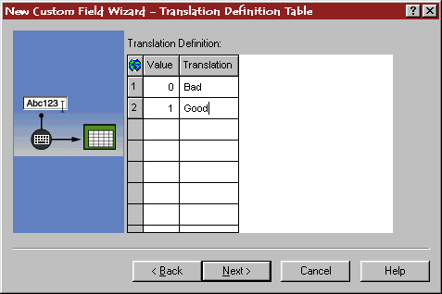
Boolean Custom Fields Example
Syntax:
  Function(Field,#)
Pct_Area_Criteria = GTE(Area%,98)
Translation:
  Any value greater than 98% returns True
  You can change the “True” expression in the translation definition table to “Good”.

Slide 36
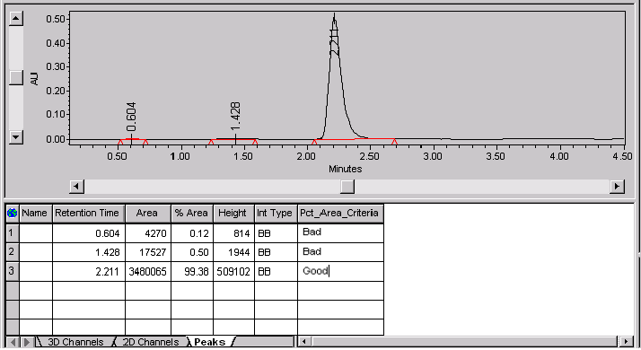
Boolean Custom Fields Example

Slide 37
Data Types
Enumerated: Enumerated fields have two possible uses:
  Provide a user with a list of possible answers.
  Translate multiple Boolean expressions into a value or answer
Two types of Enumerator Custom Fields:
  Sample
  Calculated (Peak or Result)
ENUM(Operator(Field,Value),Operator(Field,Value),Operator(Field,Value))
What is it?
Field Types
Data Types
Creation
Notes:
Enumerated lists offer these advantages over Text Data Type fields:
They are easier to select from a list rather than type in a field.
The information for each field is in a consistent and in an expected format.
Spelling and naming inconsistencies errors are reduced.
If the proper choice is not available, the analyst may specify a value, if allowed.
Note: The translation may be a value, text, or field. The USE AS selection determines the output from the field. USE AS also translates your position into a text field.
Enumerated considerations
ENUM can be used when the data type is ENUM or in a Real type formula.
ENUM must appear at the beginning of a formula if it is created for an ENUM type custom field.
There cannot be more than one ENUM function in any formula.
Only Boolean functions, or Boolean operators, are allowed in the first-level parentheses.

Slide 38
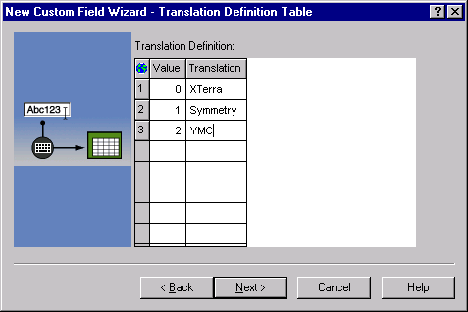
Enumerated - Sample Custom Fields EX
Field type = Sample
Field name = Column_Type
Will show up in Run Sample as a convenient drop-down list

Slide 39
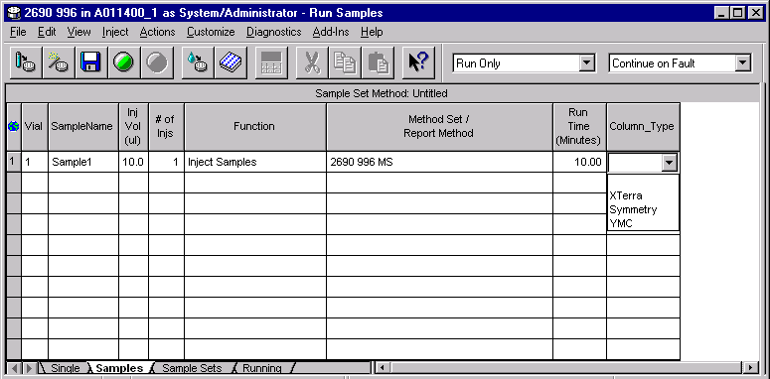
Enumerated - Sample Custom Fields EX

Slide 40
Enumerated - Sample Custom Fields EX
Useful examples:
  Column details
  Method conditions / mobile phase / pH
  Allowed product codes
  Sample descriptions, sample matrix
  Storage Conditions
  Packing Material

Slide 41


Enumerated - Calculated Custom Fields EX
ENUM(LTE(% Deviation,1),RANGE(% Deviation,1,3),GT(% Deviation,3))
Translation:
  If the % Deviation is less than or equal to 1, then “0” = “Excellent”
  If the % Deviation is between 1 and 3 (or equal to 3), then “1” = “Acceptable”
  If the % Deviation is greater than 3, then “2” = “Not Acceptable”

Slide 42
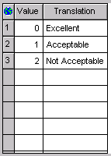
Enumerated - Calculated Custom Fields EX
Translation:
  If the % Deviation is less than or equal to 1, then “0” = “Excellent”
  If the % Deviation is between 1 and 3 (or equal to 3), then “1” = “Acceptable”
  If the % Deviation is greater than 3, then “2” = “Not Acceptable”

Slide 43
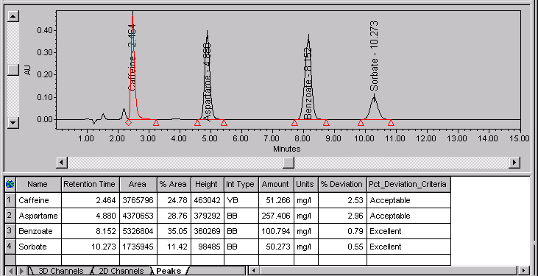
Enumerated - Calculated Custom Fields EX

Slide 44
Creating a New Custom Field
Other Fields to Fill
What is it? Why use it?
Create:
Field Types
Create:
Data Types
CF Examples
Create:
Others

Slide 45
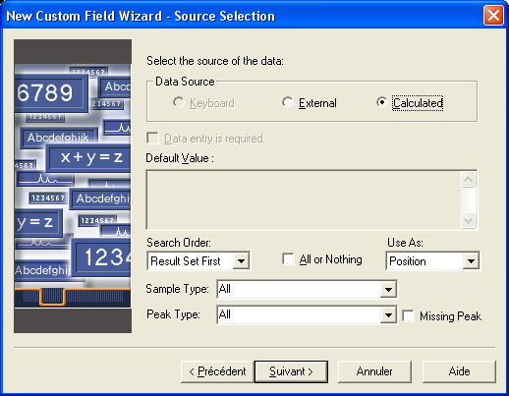
New Custom Field: Data Source Selection
Notes:
Data Source Selection
The 3rd step in the wizard is shown here.

Slide 46
New Custom Field: Data Source Selection
The Data source defines where the field value should come from.
There are several choices:
  Keyboard
    Specifies that the field value will be entered through the keyboard.
  External
    Specifies that the field value will be provided from outside the Empower database (for example, the Empower Toolkit).
  Calculated
    Specifies that the field value will be calculated by Empower software using a formula that you define.
Notes:
Data Source
The Data Source is set to Keyboard if the CF Type is Sample, Sample Set or Component, meaning that the user will enter the appropriate information into the field using the computer’s keyboard.
Calculated is chosen for all CF requiring calculations like Peak and Result type CF.
A value of External should only be selected if this field will be filled in from an application other than Empower software, if you were using the Empower Toolkit option to import information from for example a LIMS system.

Slide 47
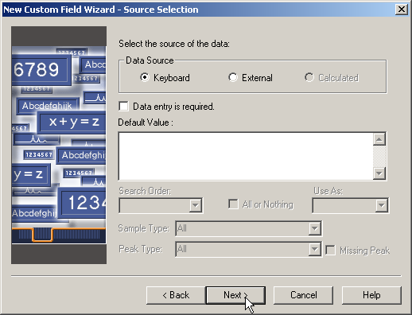
New Custom Field: Data Entry / Default Value
Notes:
Data entry is required /Default Value
The next thing to consider is if data entry is required and if you want to enter a default value.

Slide 48
New Custom Field: Data Entry / Default Value
Data entry is required
  Specifies that an entry is required in the custom field during sample loading (in Run Samples, the Sample Set Method Editor, or the Alter Sample window) or when you import data.
  If an entry is required, you cannot proceed with sample loading until you enter a value for the field.
Default value
  Specifies a default value for a custom field.
  This default value appears in the custom field if a user entry is not required.
  If the data type is Bool or Enum, the default value appears at the top of the Translation column in the Translation Definition table.
Notes:
Data entry is required /Default Value
Data entry is required specifies that an entry is required in the custom field during sample loading. If this box is selected, the user cannot proceed with acquisition until a value for the field is entered.
The Default Value allows you to specify a value that will automatically appear in this field.

Slide 49
New Custom Field: Sample Type / Peak Type
Notes:
Sample Type/Peak Type
You can restrict custom fields to be calculated only for specific types of samples and or specific types of peaks.

Slide 50
New Custom Field: Sample Type
Choose the Sample Type that you want to calculate the CF for. If a formula references a field from another result, the sample from which the result is generated must match this type for the field value to be used.
  All
  Standards Only
  Unknowns Only
  Controls Only
  Standards & Unknowns
  Standards & Controls
  Controls & Unknowns
Sample Type is available only if the Data Source is set to Calculated.
Notes:
Sample Type
You can restrict the calculation to only Standards, Samples or Controls or combination of these sample types.

Slide 51
New Custom Field: Peak Type
Choose the Peak Type that you want to calculate the CF for. If a formula references a field from another peak, its type must match this type for the field value to be used.
  All
  Founds Only
  Unknowns Only
  Groups Only
  Founds and Groups
  Founds and Unknowns
  Unknowns and Groups
Peak Type is available only if the Data Source is set to Calculated.
Notes:
Peak Type
You can restrict the calculation to only Founds, Unknowns or Groups or combination of these peak types.

Slide 52
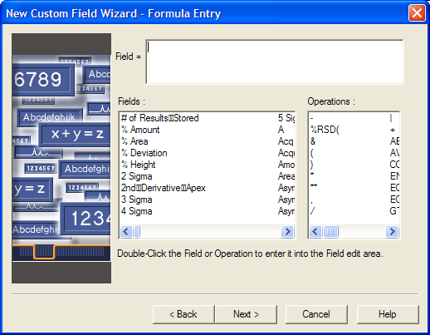
Calculations, Formula Entry
Formula Entry Area
Available Fields
Notes:
Calculation, Formula Entry
If the custom fields is calculated the next step of the wizard is to enter the formula.
Create the formula by selecting the fields from the fields list, and the mathematical functions from the operations list. You can type in the formula but you must spell exactly as spelled in the fields/operations list, so it is best to avoid typing in.
Calculation Guidelines:
Evaluation is done left to right.
Sequence precedence for basic mathematical operators is exponent, multiply, divide, add, subtract (**, *, /, +, –).
Sub expressions are specified in an expression with parentheses ( ), which must be matched. Any depth of nested sub-expressions is allowed. For ease of use and simplicity, Waters recommends that you avoid specifying more than eight levels of sub-expressions.
The Precision limit parameter must be of a sufficient value to display the calculated result.
All functions require field name variables be in parentheses (), not brackets [].
Use brackets [] when referencing a specific peak or component field directly or with the CCalRef1 and CCompRef1, CCompRef2, and CCompRef3 peak fields. For example, in CCalRef1[Area], the field name must be enclosed in square brackets.

Slide 53
Custom Fields Operators
Mathematical Operators
Mathematical Functions
-
Subtraction
ABS
Absolute value
(
Left parenthesis
COS
Cosine
)
Right parenthesis
LN
Natural log
*
Multiplication
LOG
Regular log
**
Exponent
SIN
Sine
/
Division
SQRT
Square root
+
Addition
Summary Functions
AVE
Average
MAX
Maximum value
MIN
Minimum value
SUM
Summation

Slide 54
Custom Fields Examples
What is it? Why use it?
Create:
Field Types
Create:
Data Types
CF Examples
Create:
Others

Slide 55
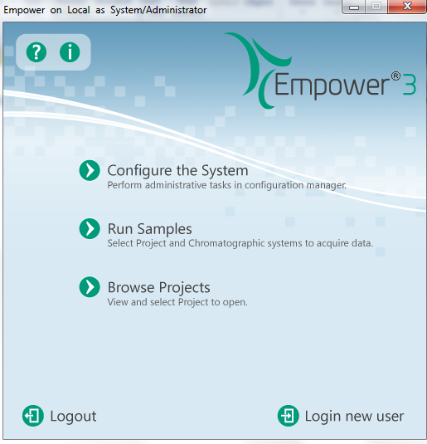
Creating Custom Fields

Slide 56
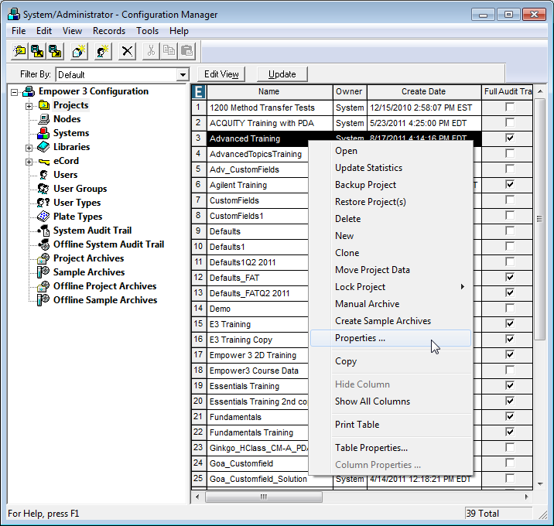
Creating Custom Fields
Notes:
Creating Custom Fields
Select Projects on the Configuration Manager tree.
Highlight the Project Name of interest.
Right-click.
Select Properties.

Slide 57
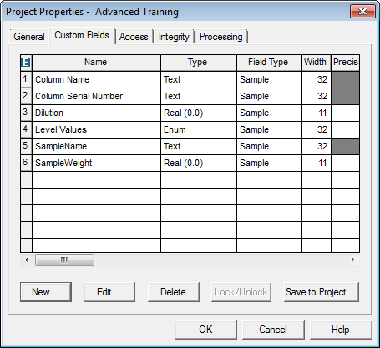
Creating Custom Fields
Notes:
Select the Custom Fields tab of the Project properties.

Slide 58
Select NEW to create a new custom field
Select EDIT to modify a custom field
Select DELETE to delete a custom field
Select LOCK/UNLOCK to prevent a custom field from being modified or allow for modification
Select SAVE TO PROJECT to save a custom field to other Projects
Select OK to accept changes and exit Project properties
Select CANCEL exit the Project properties without accepting changes
Select HELP for help with Project properties
Notes:
There are several options for Custom Fields in the Project properties.

Slide 59
Create New Sample Type Field
Goal: Enable the analyst to enter a Lot Number for each sample
Notes:
Create a new Sample Type custom field for Lot_Number.
Why Sample Type? The information could be different for each sample.
What is the Data Type?

Slide 60
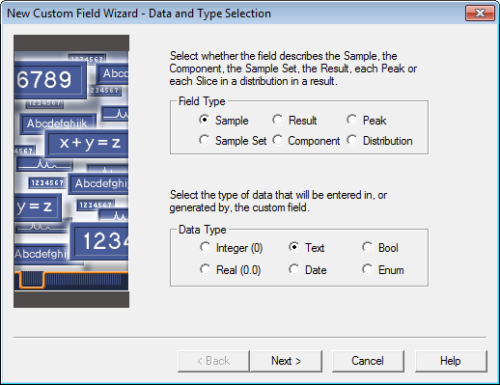
Create New Sample Type Field
Notes:
Create a new Sample Type custom field for LOT_NUMBER.
Field Type: Sample
Data Type: Text
Click Next.

Slide 61
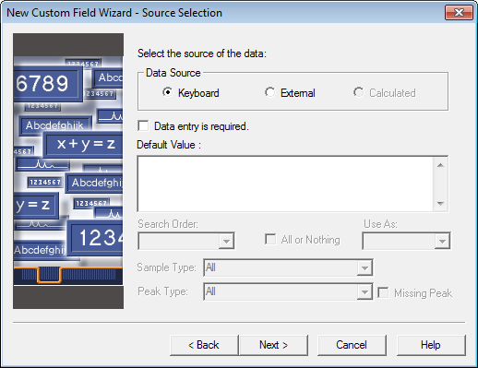
Create New Sample Type Field
Notes:
Data Source: Keyboard
Keyboard: Analyst enters information.
External: Value comes from another data source (ex. LIMS).
Calculated: Value is calculated by the software.
Data Entry Required: Analyst cannot acquire data without entering value.
Default Value: A value can be entered here and is automatically placed in the field.
Click Next.

Slide 62
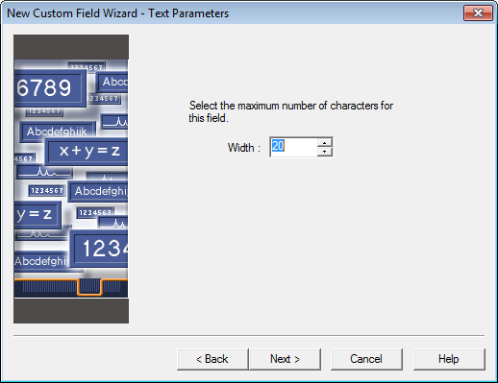
Create New Sample Type Field
Notes:
Select the character width for the new field.
Make sure you have allowed enough space for the field.
Limit the number of characters in order to help with the ease of data entry.
Click Next.

Slide 63
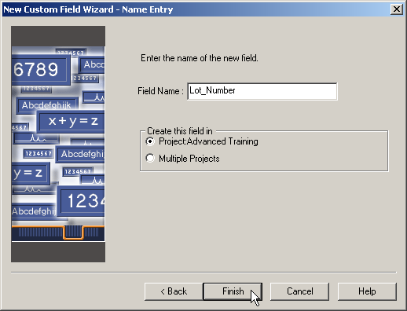
Create New Sample Type Field
Notes:
Name the new field: Lot_Number
Names must begin with a letter.
No characters are allowed in custom field names.
Create this field in only one Project.
It is possible to copy the field to other Projects after you have verified that it operates correctly.
Click Finish.
Tip: You will get a warning message indicating that if the Project is open, it will need to be closed and Empower will need to be restarted in order for the new field to be available.
Click OK.

Slide 64
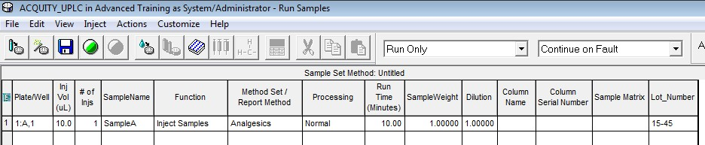
Entering: Sample Type Custom Field Info
Notes:
Entering Sample Type Custom Field Information, Lot_Number
Sample Type CF information is entered in run samples or alter samples as shown above.

Slide 65
Create New Sample Set Type Field
Goal: Create a list of USP columns for an analyst to select from when running a sequence of samples
  You want to allow the analyst to select from types L1, L3, L4, L7 or L11
Notes:
Create a new Sample Set Type custom field for HPLC_Column_Type.
Why Sample Set Type? The information is the same for each sample.
What is the Data Type?

Slide 66

Create New Sample Set Type Field
Notes:
Create a new Sample Set Type custom field for HPLC_Column_Type
Field Type: Sample Set
Data Type: Enum
Click Next.

Slide 67

Create New Sample Set Type Field
Notes:
Data Source: Keyboard.
Data Entry Required: ENABLE.
Default Value: None.
Use As: Position.

Slide 68
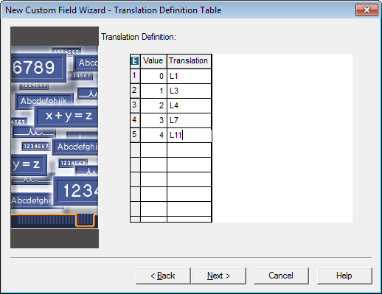
Create New Sample Set Type Field
Notes:
Translation Definition: Type in the choices you wish the analyst to have when using this field.
Enter:
L1
L3
L4
L7
L11

Slide 69
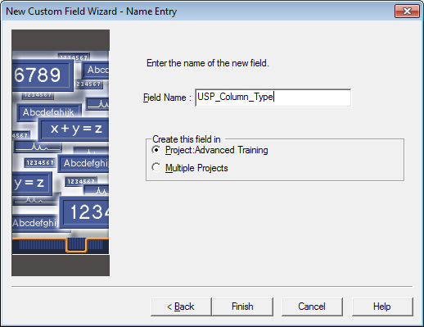
Create New Sample Set Type Field
Notes:
Name the new field: USP_Column_Type
Create this field in only one Project.
Click Finish.
Click OK

Slide 70
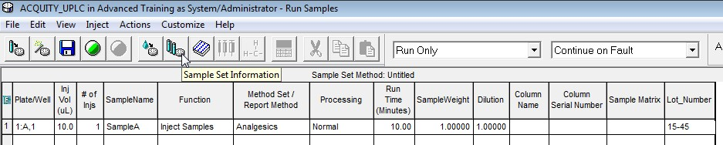
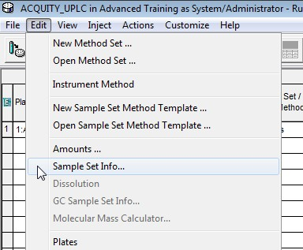
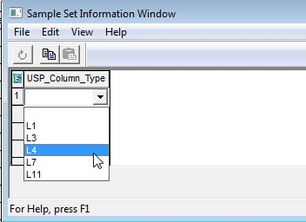
Entering: Sample Set Type Custom Field Info
Notes:
Entering Sample Set Type Custom Field Information, USP_Column_Type
Sample Set Type CF information is entered in run samples via the Sample Set Information function or via alter samples.

Slide 71
Create New Component Type Field
Goal: Have the analyst enter Label Claim in preparation to having Percent Label Claim calculated
Notes:
Create a new Component Type custom field for Label_Claim.
Why Component Type? The information could be different per component and per vial.
What is the Data Type?

Slide 72

Create New Component Type Field
Notes:
Create a new Component Type custom field for Label_Claim.
Field Type: Component
Data Type: Real (Notice Real is the only option.)
Click Next.

Slide 73
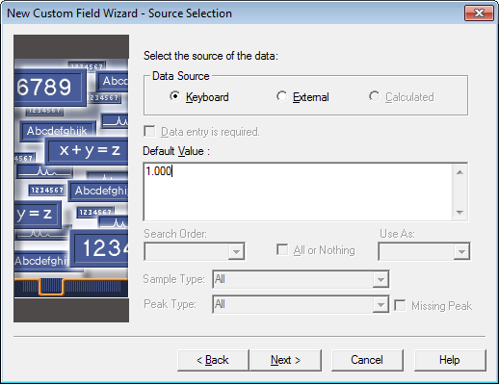
Create New Component Type Field
Notes:
Data Source: Keyboard.
Data Entry Required: Not Available.
Why is Data Entry Required unavailable?
Default Value: 1.000
Click Next

Slide 74
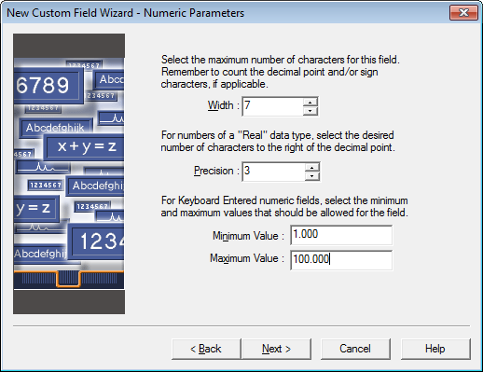
Create New Component Type Field
Notes:
Numeric Parameters
Maximum number of characters: 7
NOTE: Remember to count the decimal point and/ or sign characters.
Precision: 3
Minimum Value: 1.000
Maximum Value: 100.000
Click Next.

Slide 75
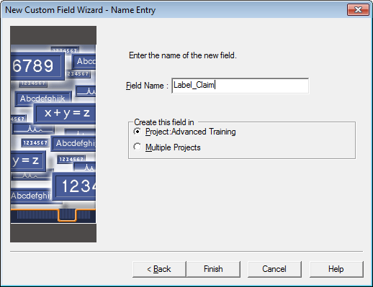
Create New Component Type Field
Notes:
Name the new field: Label_Claim
Create this field in only one Project.
Click Finish.
Click OK

Slide 76
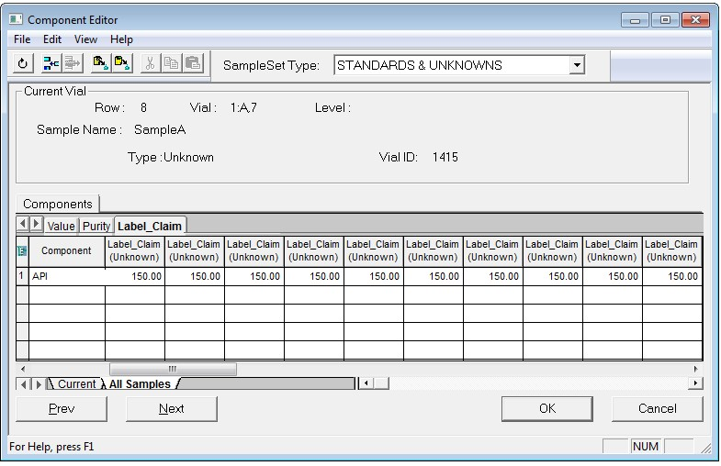
Entering: Component Type Custom Fields Info
Notes:
Entering Component Type Custom Field Information, Label_Claim
A new tab will appear with the name of the Component Custom Field, here Label_Claim.
Since we added the value 150 as a default value for this CF it is automatically filled.

Slide 77
Create New Peak Type Field
Goal: Have Empower calculate Percent Label Claim
Notes:
Create a new Peak Type custom field for Percent_Label_Claim.
Why Peak Type? This field is calculated by Empower.
What is the Data Type?
What is the Formula?

Slide 78

Create New Peak Type Field
Notes:
Create a new Peak Type custom field for Percent_Label_Claim.
Field Type: Peak
Data Type: Real
Click Next.

Slide 79
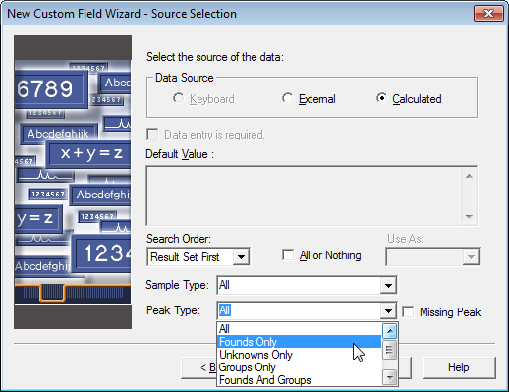
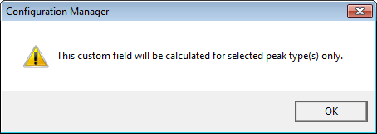
Create New Peak Type Field
Notes:
Data Source: Calculated
Sample Type: All
Peak Type: Founds Only
Click OK
Click Next

Slide 80
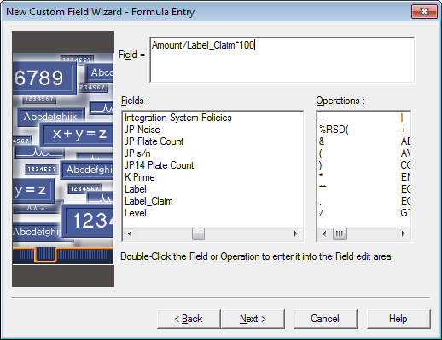
Create New Peak Type Field
Notes:
Create the formula by selecting from the available fields list and operations.
Note: Do Not type Field Names or Mathematical Operators.
The Formula:
Field= Amount/Label_Claim*100
Double click Amount.
Double click /.
Double click Label_Claim.
Double click *.
Type 100 from your keyboard.
Click Next

Slide 81

Create New Peak Type Field
Notes:
Maximum number of characters: 12
Tip: Remember to count the decimal point and/ or sign characters.
Precision: 3
Click Next

Slide 82

Create New Peak Type Field
Notes:
Name the new field: Percent_Label_Claim
Create this field in only one Project.
Click Finish.

Slide 83
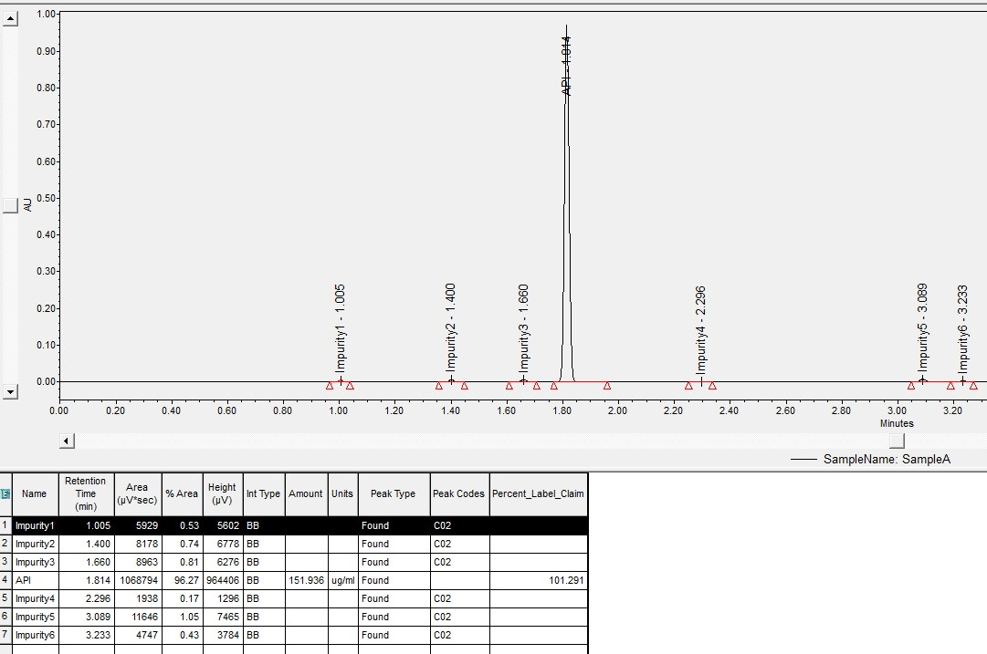
Viewing: Result of Peak Type CF Calculation
Notes:
Viewing the result of a Peak Type Custom Field calculation, Percent_Label_Claim
Since Percent_Label_Claim is a Peak type custom field it will appear in the peak table in review when the chromatogram has been integrated and quantitated.

Slide 84
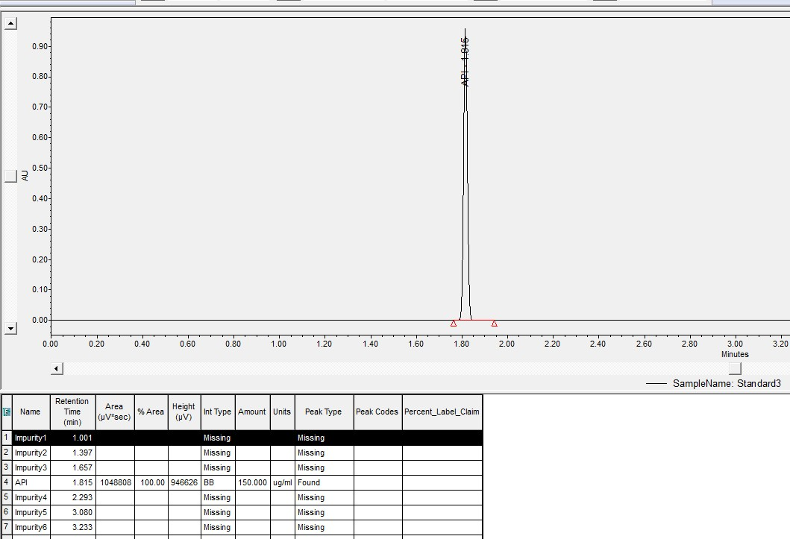
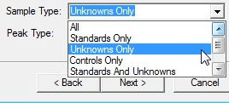
Viewing: Result of Peak Type CF Calculation
Not calculated for Standard
Notes:
Viewing the result of a Peak Type Custom Field calculation, Percent_Label_Claim
Since we asked for this CF to only be calculated for unknowns results will not appear for a standard as shown above.

Slide 85
Create New Peak Type Field (Bool)
Goal: Have Empower notify an analyst if a sample is Outside Potency Limits or at Acceptable Potency
Notes:
Create a new Peak Type custom field for Potency.
Why Peak Type? This field is calculated by Empower.
What is the Data Type?
What is the Formula?

Slide 86
Custom Fields Operators
Mathematical Operators
Mathematical Functions
-
Subtraction
ABS
Absolute value
(
Left parenthesis
COS
Cosine
)
Right parenthesis
LN
Natural log
*
Multiplication
LOG
Regular log
**
Exponent
SIN
Sine
/
Division
SQRT
Square root
+
Addition
Summary Functions
AVE
Average
MAX
Maximum value
MIN
Minimum value
SUM
Summation

Slide 87
Boolean Operators
Boolean Functions
Special Functions
ENUM
Enumeration
ROUND
Round
EQ
Equal
REPLACE
Replace value
GTE
Greater than or equal
LT
Less than
LTE
Less than or equal
Boolean Operators
NEQ
Not equal
&
AND
RANGE
Range
|
OR
,
Comma separator

Slide 88

Create New Peak Type Field (Bool)
Notes:
Create a new Peak Type custom field for Potency.
Field Type: Peak
Data Type: Bool
Click Next.

Slide 89
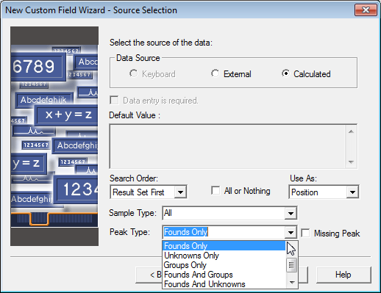
Create New Peak Type Field (Bool)
Notes:
Data Source: Calculated
Use As: Position
Sample Type: All
Peak Type: Founds Only
Click OK to dialog box message
Click Next

Slide 90
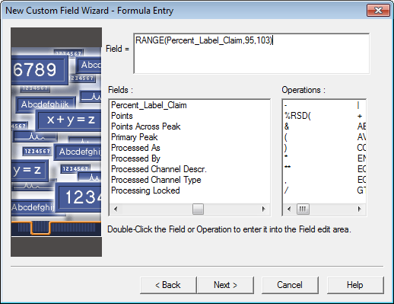
Create New Peak Type Field (Bool)
Notes:
Create the formula by selecting from the available fields list and operations. Do not type Field Type Names or Mathematical Operators.
The Formula:
Field= RANGE(Percent_Label_Claim,95,103)
Double click RANGE.
Double click Percent_Label_Claim.
Type , from your keyboard.
Type 95 from your keyboard.
Type , from your keyboard.
Type 103 from your keyboard.
Double click ).
Click Next

Slide 91
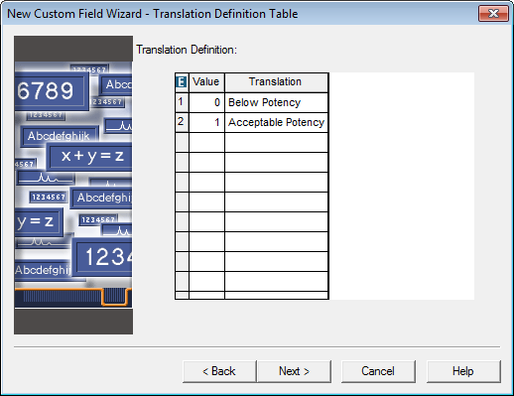
Create New Peak Type Field (Bool)
Notes:
Translation Definition:
0: Below Potency.
1: Acceptable Potency.
Click Next

Slide 92

Create New Peak Type Field (Bool)
Notes:
Name the new field: Potency
Create this field in only one Project.
Click Finish.
Click OK

Slide 93
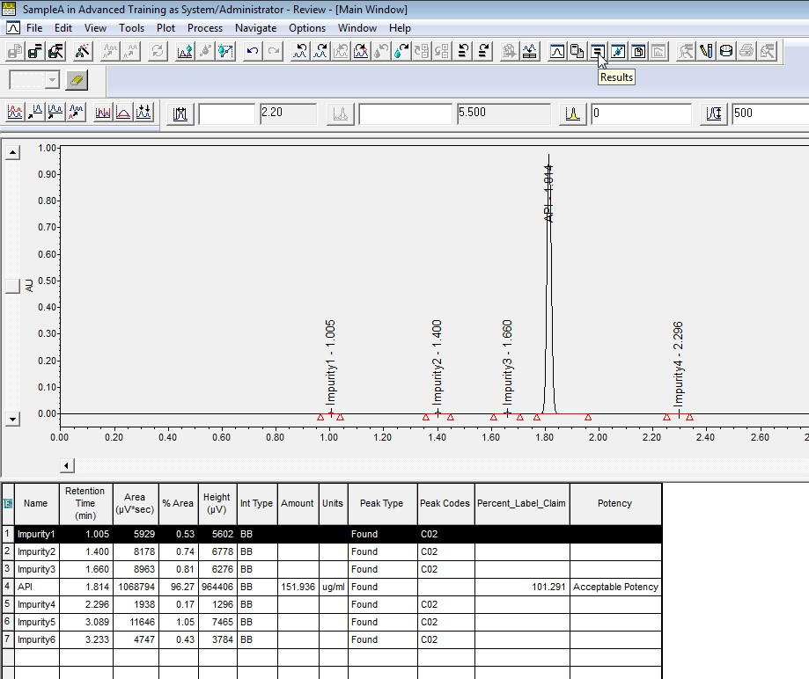
Viewing: Results for a Peak (Bool) CF
Notes:
Viewing results for a Peak Type Boolean Custom Field, Potency.
The result of the boolean calculation for the Potency can be viewed in the peak tabel in review.

Slide 94

Possible Issues
What are the possible issues with this calculation?
  Does not differentiate ‘low’ versus ‘high’ potency
  RANGE may be difficult to control because of the way it calculates > for the lower number, and <= for the higher number
How else could you do this calculation? Can it be improved?

Slide 95
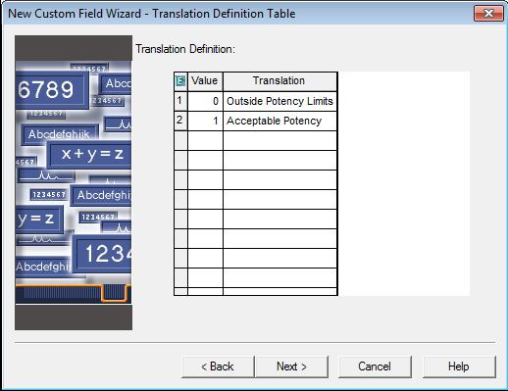
Possible Issues – Unclear Wording
The Words Used are Critical to Understanding

Slide 96
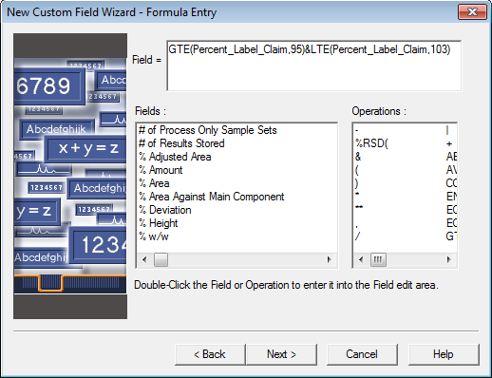
Possible Issues – Removing Use of RANGE
Note the use of the ‘&’ (AND) operator between the two parts

Slide 97


Possible Issues – Removing Use of RANGE
Note the use of the ‘I’ (OR) operator between the two parts

Slide 98

Possible Issues – Greater Clarity
ENUM(
LT(Percent_Label_Claim,95),
GT(Percent_Label_Claim,103),
GTE(Percent_Label_Claim,95)&LTE(Percent_Label_Claim,103)
)
Many ways to do the same thing!

Slide 99
Create New Result Type Field
Goal: Have Empower notify an analyst if Detector Noise is acceptable
Notes:
Create a new Result Type custom field for Noise_Criteria.
Why Result Type? This field is calculated by and provides ONE answer for the entire chromatogram.
What is the Data Type?
What is the Formula?

Slide 100

Create New Result Type Field
Notes:
Create a new Result Type custom field for Noise_Criteria.
Field Type: Result
Data Type: Bool
Click Next.

Slide 101
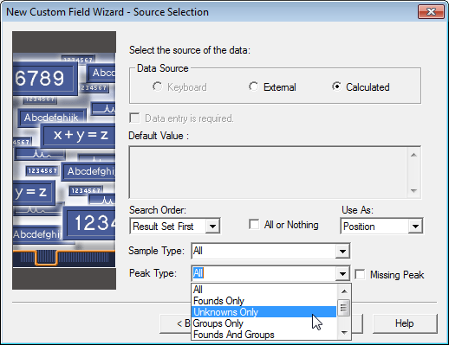
Create New Result Type Field
Notes:
Data Source: Calculated
Use As: Position
Sample Type: All
Peak Type: Unknowns Only
Click OK to dialog box message
Click Next

Slide 102
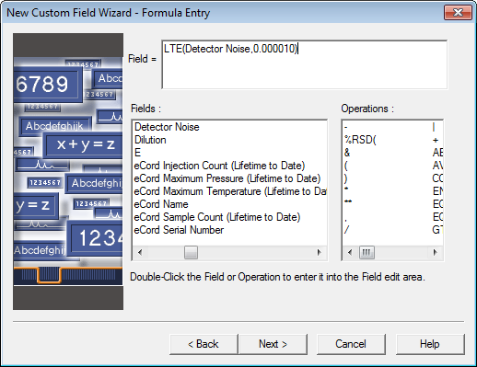
Create New Result Type Field
Notes:
Create the formula by selecting from the available fields list and operations. Do not type Field Names or Mathematical Operators.
The Formula:
Field= LTE(Detector Noise,0.000010)
Double click LTE.
Double click Detector Noise.
Type ,0.000010 from your keyboard.
Double click ).
Click Next

Slide 103

Create New Result Type Field
Notes:
Translation Definition:
0: Check Noise
1: Acceptable Noise
Click Next

Slide 104

Create New Result Type Field
Notes:
Name the new field: Noise_Criteria
Create this field in only one Project.
Click Finish.
Click OK

Slide 105
Viewing: Results for a Result Type CF
Notes:
Viewing the result of a Result Type Custom Field calculation, Detector_Noise_Criteria
Result type CF can be viewed in the results view in the review window.

Slide 106
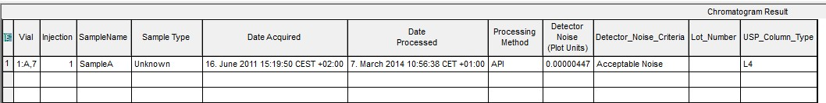
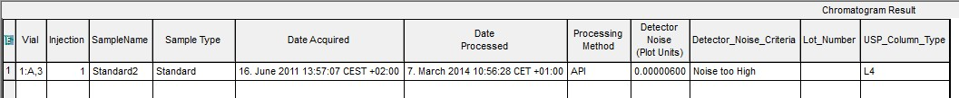
Viewing: Results for a Result Type CF
Notes:
Viewing the result of a Result Type Custom Field calculation, Detector_Noise_Criteria
It is found in the Chromatogram Result table.

Slide 107
Advanced Custom Fields Creation

Slide 108
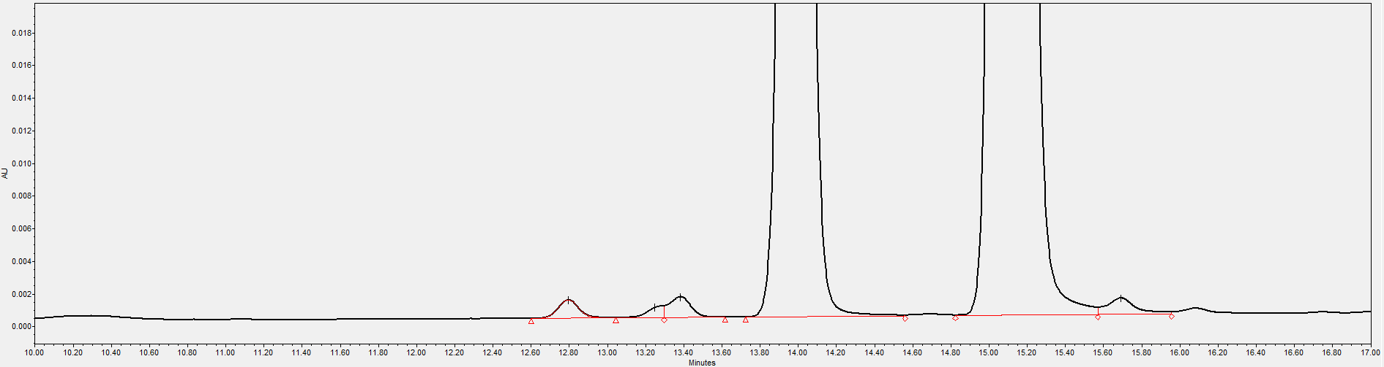
Peak Type Field with Reference to Peak Name
Calci
preCalci
Syntax for referencing a specific peak: Peak Name[Field]
Peak Custom Field to correct the area of the preCalci peak by a factor of 1.92 and add this to the area of the Calci peak:
(preCalci[Area]*1.92)+Calci[Area]
Note: Spelling of peak names has to match the spelling in the component table of the processing method.
Notes:
Peak Type field with Reference to Peak Name
Problem: : The Calci peak has to reversible equilibrium forms that separate into two peaks, preCalci and Calci. The UV extinction coefficient for the preCalci from is lower than the one for the Calci form. This needs to be taken into account when creating the calibration curve. We need to multiply the area of the preCalci peak with 1.92 and then add this to the area of the Calci peak and create the calibration curve from this Corrected Area.

Slide 109
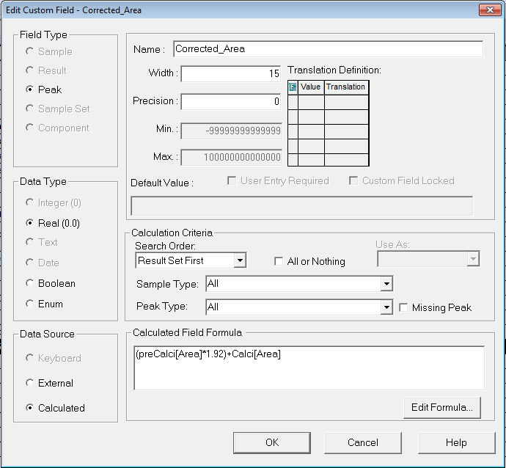
Peak Type Field with Reference to Peak Name
Custom Field: Corrected_Area = (preCalci[Area]*1.92)+Calci[Area]
Notes:
Peak Type field with Reference to Peak Name
This is the CF we need to do the calculation of the corrected area.

Slide 110
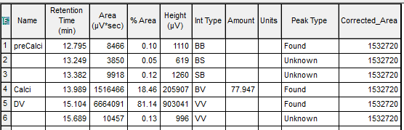
Viewing: Results of Peak Type CF
Calci
preCalci
CF result is shown for all peaks, but it is the same =
1.92 x 8466 + 1516466
Why is CF result shown for all peaks?
Notes:
Viewing the result of the CF
The result of the CF calculation will be shown for all peaks in the peak table.

Slide 111

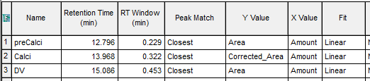
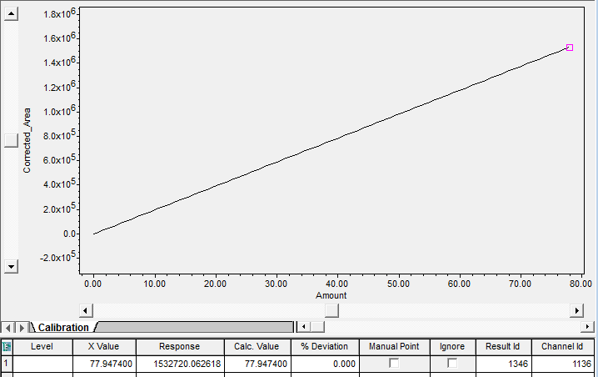
Using Corrected Area as Y-Value in Calibration
Notes:
Using the Corrected Area as Y-Value in the Calibration Curve
We will also need to use the corrected area as the basis for the calibration curve Y-value (response).
This is done by choosing the CF under Y Value in the component table of the processing method.
The Corrected_Area (name of the CF) will then also appear on the calibration curve plot.

Slide 112
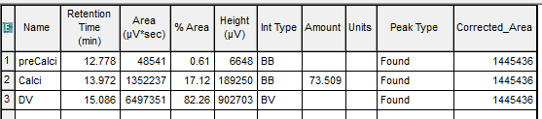
Using Corrected Area as Y-Value in Calibration
Calci
preCalci
Corrected Area used to calculate Amount
Notes:
Calculating an Unknown Sample
The corrected area will then also be used to calculate the amount for the Calci peak.
There are two problems with this approach :
The result of the CF appears for all peaks.
The calculation is very specific for the specific method since we refer to specific peak names.

Slide 113

Creating Generic CF referring to Specific Peaks
In the Formula Entry window of the CF wizard we can choose the CCompRef1 and CCompRef2 as the ”peak names” and use the CConst1 as the multiplier.
Formula is now: (CCompRef1[Area]*CConst1)+CCompRef2[Area]
Notes:
Creating a more generic CF referring to specific peaks
Instead of referring to specific peak names we can use the CCompRef (Custom Component Reference).
Insted of a specific value (in this case 1.92) we can use the Cconst (Custom Constant) value.
There are 3 different CCompRef names and 7 CConst values to choose from.
In this case we will use CCompRef1 instead of preCalci and CCompRef2 instead of Calci and use CConst1 instead of the value 1.92

Slide 114

Creating Generic CF referring to Specific Peaks
Corrected Area only shown for the Calci peak
Notes:
Selecting the CCompRef 1 and 2 and CConst 1 in the Processing Method.
We have now created a CF that can be used with any method since the processing method defines which peaks to use and what value to multiply with. The result of the CF will also only be shown for the peak of interest.

Slide 115
Create New Peak Type Field
Goal: Have Empower calculate Relative Retention Time for unknowns based on one selectable reference peak
Notes:
Create a new Peak Type custom field for Relative_RT.
Why Peak Type? This field is calculated by Empower.
What is the Data Type?
What is the Formula?
How can the reference peak be selectable by an analyst?

Slide 116
Create New Peak Type Field
Notes:
Create a new Peak Type custom field for Relative_RT.
Field Type: Peak
Data Type: Real
Click Next.

Slide 117

Create New Peak Type Field
Notes:
Data Source: Calculated
Sample Type: All
Peak Type: Unknowns Only
Click OK to dialog box message
Click Next

Slide 118

Create New Peak Type Field
Notes:
Create the formula by selecting from the available fields list and operations. Do not type Field Type Names or Mathematical Operators.
The Formula:
Field= Retention Time/CCalRef1[Retention Time]
Double click Retention Time.
Double click /.
Double click CCalRef1.
Double click Retention Time.
Type ] from your keyboard.
Click Next

Slide 119
Create New Peak Type Field
Notes:
Numeric Parameters
Maximum number of characters: 12
Tip: Remember to count the decimal point and/ or sign characters.
Precision: 3
Click Next

Slide 120

Create New Peak Type Field
Notes:
Name the new field: Relative_RT
Create this field in only one Project.
Click Finish.
Click OK

Slide 121

Where do We Input Data for…
Sample Information?
Sample Set Information?
Component Information?
Notes:
Summary
This gives an overview of where you enter values for Sample, Sample Set and Component Type custom fields.

Slide 122
Where do We Input Data for…
Sample Information?
Sample Set Information?
Component Information?
Notes:
Summary
This gives an overview of where you enter values for Sample, Sample Set and Component Type custom fields.

Slide 123




Input Data in Run Samples or Alter Data
Sample Information
Component Information
Sample Set Information
Notes:
Summary
This gives an overview of where you enter values for Sample, Sample Set and Component Type custom fields.

Slide 124
Important Info when Figuring out a CF?
What is the mathematical formula?
What fields are required?
Does Empower generate the fields by default or do they need to be created?
Are your peaks named?
Is the calculation on samples, standards? All of them?
Is this a field/ calculation needed for several products?
What type of field is it?
What type of data will be reported out from the field?
Notes:
Important considerations when creating custom fields
When creating custom fields it is important to figure out the details of the field before beginning in Empower. Below are some suggestions of things you might consider.
What is the mathematical formula?
What fields are required?
Does Empower generate the fields by default or do they need to be created?
Are your peaks named?
Is the calculation on samples, standards? All of them?
Is this a field/ calculation needed for several products?
What type of field is it?
What type of data will be reported out from the field?

Slide 125
Summary
Empower allows you the flexibility to create fields not already existing in the software.
Fields can be simple user entered information.
Fields can be customized calculations.
Fields created by you can be used in customized calculations.

Slide 126
Custom Fields:
Advanced
Part 2 – Advanced Custom Fields
Notes:
Waters Confidential and Proprietary Information

Slide 127
Content
Boolean Custom Fields
  Using CCompRef and CConst
Enumerated Custom Fields
  Using CCalRef1
  Using the “Use As” function
  The Round and Replace functions
Custom Fields Calculations Special Values
Intersample and Intersample Summary Calculations
  Syntax and rules
  The “Search Order” function
  The “All or Nothing” function
Notes:
Content
In this chapter we will look at the more advanced custom fields.
These includes are more in depth look at Boolean and
Enumerated Custom Fields
We will also look at InterSample and InterSample Summary
calculations

Slide 128

Custom Field (Examples)
Determination of Theobromine (ThBr) and Caffeine (Caf) in tea is used in the Custom Field examples
Notes:
Custom Field Examples
In some of the exaples we use this separation to illustrate the
various custom calculations.
It is a simple separation of only two components, Theobromine
and Caffeine.

Slide 129
Boolean Custom Field

Slide 130
Boolean Custom Fields
Boolean: Boolean fields allow you to translate a mathematical formula into a specific value, or answer upon processing.
  Operator(Field,Value)
  Two possible answers.
    1 or 0
    Yes or No
    Pass or Fail
    User defined choice.
      example 0 – out of range, 1 – within range
  May translate into a field.
Notes:
Boolean Custom Fields
Boolean and Enumerated custom fields allow you to create very flexible and useful custom fields. Boolean and Enumerated Sample Type custom fields allow you to define a specific list of choices for the field. Boolean and Enumerated Peak and Result Type custom fields allow you to translate a mathematical formula into a specific value, or answer. Boolean fields always have two possible answers and are typically a yes/no or a true/false type situation. Enumerated fields have multiple possible answers, for example Good, Better, Best. The number of possible answers is defined by the user when creating this type of custom field.
If a Boolean expression is true (in the example above if the %Area is greater than 5) the outcome will be a 1 if not it will be a 0. The 0 and 1 value can then be translated into a text or another value.
Boolean Operators:
LT – Less than
LTE – Less than or equal to
GT – Greater than
GTE – Greater than or equal to
EQ – Equal to
NEQ – Not equal to
RANGE – Range
EQI – Case-insensitive, used with string comparison
NEQI – Case-insensitive, used with string comparison
Example Statement:

Slide 131
Boolean Custom Fields
Boolean Operators / Functions
GT( | Greater than
GTE( | Greater than or equal
LT( | Less than
LTE( | Less than or equal
EQ( | Equal
NEQ( | Not equal
EQI ( | Equal, case insensitive
NEQI( | Not equal, case insensitive
RANGE( | Range
ENUM( | Enumerated
Boolean Operators
& | AND
| | OR
, | Comma separator
Notes:
Boolean Operators/Functions
This is list of the different Boolean Operators you can use.
The AND (&) and OR (|) function are used to combine 2 or more Boolean expressions.

Slide 132
Boolean Custom Fields – Examples
Boolean Operators / Functions
GT(%Area,15) | If %Area is > 15 returns a 1, if not returns a 0
GTE(%Area,15) | If %Area is ≥ 15 returns a 1, if not returns a 0
LT(%Area,15) | If %Area is < 15 returns a 1, if not returns a 0
LTE(%Area,15) | If %Area is ≤ 15 returns a 1, if not returns a 0
EQ(Name,”Acetone”) | If Name = Acetone (spelled with capital A) returns a 1, if not returns a 0
NEQ(Name,”Acetone”) | If Name ≠ Acetone (spelled with capital A) returns a 1, if not returns a 0
EQI(Name,”acetone”) | If Name = Acetone (spelling case does not matter) returns a 1, if not returns a 0
NEQI (Name,”acetone”) | If Name ≠ Acetone (spelling case does not matter) returns a 1, if not returns a 0
RANGE(%Area,15,20) | If %Area is > 15 and ≤ 20 (15 is not included but 20 is included) returns a 1, if not return a 0
Notes:
Boolean Operators/Functions, Examples
This is list shows examples of the different Boolean Operators you can use.

Slide 133

Example 1 Boolean CF
GT(Area,20000)
  Any Area above 20000 is true
GT(ThBr[Area],20000)
  The Area of ThBr above 20000 is true
GT(ThBr[Area],20000)&GT(Caf[Area],400000)
  The Area of ThBr above 20000 and the Area of Caf above 400000 is true
GT(ThBr[Area],20000)|GT(Caf[Area],400000)
  The Area of ThBr above 20000 or the Area of Caf above 400000 is true
Notes:
Boolean Examples
Above you will find some examples of Boolean Custom Fields.
They are all testing is the Area is Greater Than some specific
values. If the expression are true the outcome will be a 1 and this is then translated into True. If the expression is not true, the outcome is a 0, which is translated into False.
In some of the examples we are referring to specific peak names (ThBr and Caf), but in the last example we have replaced the names with CCompRef1 and the value with CConst1, to make the calculation more generic. In this case we will have to specify in the processing method what CCompRef1 and CConst1 are.

Slide 134

Example 1 Boolean CF
GT(CCompRef1[Area],CConst1)
  CCompRef1 and CConst1 are specified in the Processing Method
20000
400000
Notes:
Boolean Examples
Above you will find some examples of Boolean Custom Fields.
They are all testing is the Area is Greater Than some specific
values. If the expression are true the outcome will be a 1 and this is then translated into True. If the expression is not true, the outcome is a 0, which is translated into False.
In some of the examples we are referring to specific peak names (ThBr and Caf), but in the last example we have replaced the names with CCompRef1 and the value with CConst1, to make the calculation more generic. In this case we will have to specify in the processing method what CCompRef1 and CConst1 are.

Slide 135

Example 1 Boolean CF
GT(CCompRef1[Area],CConst1)
Notes:
Example 1
Here we see how the last example is created.
Since we want to calculate on peaks we use the Field Type = Peak.
The Data Type is Boolean.
In the Translation definition table we type in what the translation
of 0 and 1 should be, in this case False and True

Slide 136

Example 1 Boolean CF
GT(CCompRef1[Area],CConst1)
Notes:
Example 1
When we process a sample the Custom Field is calculated. By using CCompRef1 and CConst1 we can have different criteria for each peak.

Slide 137

Example 1 Boolean CF
Change CF existing to meet criteria: ThBr > 20000 and Caf > 400000
Notes:
Example 1
We now want to change the criteria so both of the criterias are
fulfilled at the same time.
We can edit the existing custom field.

Slide 138


Example 1 Boolean CF
GT(CCompRef1[Area],CConst1)&GT(CCompRef2[Area],CConst2)
Notes:
Example 1
When you open the Custom Field editor you can from here edit the formula.
By using the “&” function between the two Boolean expressions BOTH have to be fulfilled at the same time to get a 1, and a pass in this case.

Slide 139

Example 1 Boolean CF
Notes:
Example 1
This is how the edited Custom Field now looks.

Slide 140

Example 1 Boolean CF
GT(CCompRef1[Area],CConst1)&GT(CCompRef2[Area],CConst2)
Component Table
Notes:
Example 1
The ThBr peaks passes the test (Area = 25800 > 20000), but
since the Caf Peak does not (Area = 399190 < 400000), the
overall outcome of the Custom Filed is a Fail.
In the example above we did not need to use both CCompRef1 and 2, but could have just used CCompRef1, since we can specify a CCompRef for each component in the component table of the processing method.

Slide 141
Enumerated Custom Fields

Slide 142
Example 2: Enumerated Custom Field
Enumerated Custom field with is a data type with one or more Boolean expressions
Boolean: Only two possible outcomes/answers
Fail/Pass
GT(CCompRef1[Area],CConst1)
Enumerated: More than two possible answers: Low/Good/High
ENUM(LT(CCompRef1[Area],CConst1),
RANGE(CCompRef1[Area],CConst1,CConst2),
GT(CCompRef1[Area],CConst2))
The same functions and operators apply as in Boolean
An Enumerated CF always starts with: ENUM
Notes:
Example 2, Enumerated Custom Field
A Boolean Custom Field can only have two different outcomes or
answers, 0 or 1 or Fail/Pass.
An Enumerated Custom Field can have more than two possible
outcomes or answers.
An Enumerated CF alwasy starts with ENUM, and the same
functions and operators as in Boolean fields apply.
In the example above we have combined 3 Boolean expressions and therefore we can have 3 possible outcomes, 0,1 and 2 which we can translate to f.ex Low/Good/High
Note: The Boolean expressions in an Enumerated field must be mutually exclusive. The field is evaluated from left to right, so when a statement is fulfilled the evaluation stops.

Slide 143


Example 2: Enumerated Custom Field
Sometimes a Field is too big and does not fit the window.
When you get an error message:
Copy the Field to Word or Wordpad where it is easier to troubleshoot.
Notes:
Example 2, Enumerated Custom Field
If a formula is incorrect you will get an error message, when you click Next in the CF wizard.
In the case above the formula is to big to fit into the formula entry area, so you cannot view the entire formula. In this case you can copy the formula into a word editor like Word or Wordpad, to better view the whole formula.

Slide 144


Example 2: Enumerated Custom Field
Copy to word
ENUM(LT(CCompRef1[Area],CConst1),RANGE(CCompRef1[Area],CConst1,CConst2),GT(CCompRef1[Area],CConst2))
) was missing
Copy this back to Formula field
Notes:
Example 2, Enumerated Custom Field
After copying we can see the we have missed a parenthesis at the
end of the formula.
We can type this in in the Word document, and then copy and
paste the formula back into the CF wizard.

Slide 145


Example 2: Enumerated Custom Field
Low
Good
High
ENUM(LT(CCompRef1[Area],CConst1),RANGE(CCompRef1[Area],CConst1,CConst2),GT(CCompRef1[Area],CConst2))
Notes:
Example 2, Enumerated Custom Field
In the Translation definition Table we will have to enter 3
translations, since we have 3 Boolean expressions.

Slide 146

Example 2: Enumerated Custom Field
ENUM(LT(CCompRef1[Area],CConst1),RANGE(CCompRef1[Area],CConst1,CConst2),GT(CCompRef1[Area],CConst2))
Notes:
Example 2, Enumerated Custom Field
Since the Area of the ThBr peak is within the range 20000 to 40000 we get a Good for this peak, but the Area of the Caf peak is lower than 400000 so we get a Low for this peak.

Slide 147

Example 3 Boolean CF Area_Limit/Area_GT05
(Explanation of Use As)
Example 3:
Calculate the % Area above 0.5% of the Main Component Caf.
First Custom Field: Area_Limit=GT(Area,(Caf[Area]*0.005))
Notes:
Example 3
In this example the challenge is to calculate the %Area as a percentage of the main peak (Caf) but only for the peaks that have an Area% that is above 0.5% of the Caf peak.
First we need to create a CF that can pinpoint the peaks that have an area the is greater than 0.5% of the Caf peak.
The formula is : GT(Area,(Caf[Area]*0.005)). If the Area of a peak is greater then 0.5% of the Caf peak we will get a 1, if not we will get a 0.

Slide 148

Example 3 Boolean CF Area_Limit/Area_GT05
GT(Area,(Caf[Area]*0.005))
GT(Area,(Caf[Area]*0.005))
GT(Area,Caf[Area]*0.005)
Notes:
Example 3
In the translation table we use 0 and 1.
We name the field Area_Limit.

Slide 149

Example 3 Boolean CF Area_Limit/Area_GT05
Notes:
Example 3
Here we see the result of the Custom Field calculation. All peaks with an area % greater than 0.5% of the main peak (Caf) gets a 1 the others get a 0.

Slide 150

Example 3 Boolean CF Area_Limit/Area_GT05
GT(Area,CCompRef1[Area]*0.005)
Change the Caf to CCompRef1 to make it more general
Notes:
Example 3
If we want to make the CF more generic we can use CCompRef1
instead of the peak name Caf.

Slide 151

Example 3 Boolean CF Area_Limit/Area_GT05
GT(Area,(CCompRef1[Area]*0.005))
Problem : CF only calculated for the Caf peak. Unknown peaks cannot be included !!
Notes:
Example 3
The problem with this is that then the CF is only calculated for the Caf peak, since we cannot specify CCompRef for alle the unknown peaks that are not part of the component table.

Slide 152
Example 3 Boolean CF Area_Limit/Area_GT05
CCompRef
  Custom Component Reference, the field in the Components table that identifies one or more peaks to be referenced when custom results are to be calculated based on the specified peaks. Use CCompRef1 to CCompRef3 where average ratios and other interpeak calculations are needed for calculation.
  The field in the Processing Method window that specifies a peak to be used in a custom calculation formula applied to all components in a result.
CCalRef
  Custom Calculation Reference, the field in the Processing Method window that specifies a reference peak to be used in a custom calculation that is applied to all components in a result.
  CCalRef is used for calculating interpeak custom results for all peaks in the Components table (in the Processing Method window).
So, We will Change CCompRef1 to CCalRef1
Notes:
Example 3
Above you see the explanation for how CCompRef, Cconst and
CCalRef are used.
So in our example we can change to CCalRef1 instead of using
CCompRef1.

Slide 153

Example 3 Boolean CF Area_Limit/Area_GT05
GT(Area,CCalRef1[Area]*0.005)
Notes:
Example 3
Here we see the changed formula.

Slide 154

Example 3 Boolean CF Area_Limit/Area_GT05
Notes:
Example 3
In this case the CF will be calculated for all peaks.

Slide 155

Example 3 Boolean CF Area_Limit/Area_GT05
Next step is to multiply the Area with Area_Limit.
Second Custom Field: Area_GT_05=Area*Area_Limit
Area*Area_Limit
Notes:
Example 3
The next step is then to create a custom field that will only show the are of the peaks with an Area% greater than 0.5% of the main peak.
This is easy we just create a field where we multiply the Area with the Area_Limit CF we just created. This will multiply the Area with 1 if the area% is greater than 0.5% and with 0 if it is not.

Slide 156

Example 3 Boolean CF Area_Limit/Area_GT05
Area_GT_05=Area*Area_Limit
Will only show areas that
are > 0.5% of the Caf area
Notes:
Example 3
Here we see the result of this CF, called Area_GT_05.

Slide 157


Example 3 Boolean CF Area_Limit/Area_GT05
Use As Position
Use as: Position. Calculates with the value column then you can enter text in the translation column.
With this CF it is possible to use it in further calculations
Notes:
Example 3
Lets go back to the first CF we created, Area_Limit. Instead of using 0 and 1 in the translation table we would like the outcome to to be < 0.5% and > 0.5%. But we need the 0 and 1 for our further calculation in the CF “Area_GT_05”.
This can be accomplished by using the “Use As” function in the CF wizard, which is directly related to Boolean and Enumerated CF.
By setting the Use As to Position, the 0 and 1 in the value column will be used in any further calculation where this CF is used, but the translation column will be the outcome of the CF itself.

Slide 158

Example 3 Boolean CF Area_Limit/Area_GT05
In this case the result of the CF Area_Limit will be <0.5% or >0.5%, but in any subsequent CF calculations the value 0 or 1 will be used.
Since we use Area_Limit in the CF Area_GT_05, 0 and 1 will be used in this CF.
GT(Area,CCalRef1[Area]*0.005)
Notes:
Example 3
This is how the changes we make to the Area_Limit CF looks like.

Slide 159

Example 3 Boolean CF Area_Limit/Area_GT05
Notes:
Example 3
Here we see the result of the new calculation. Area-Limit now shows < 0.5% or > 0.5% whereas the Area_GT_05 is the same as before.

Slide 160
Use as function
If you specified a data type as either Enum or Bool in the Data and Type Selection page, select how you want to interpret or use the item you select or selected by a formula.

Slide 161


Use as Function
Position
  Uses the position (index) of the selected item in the Translation definition table. It starts at 0. The first item of the translation definition table is at position 0. The second one is at position 1 and etc. When Use As of a custom field is set to Position, the selected item gets translated to a position. Specifying this kind of custom field in a subsequent formula enables the use of position based calculations.
Notes:
The “Use As” function
There are 4 possible choices for the “Use As” function.
Position : This will use the number in the value column of the translation definition table, 0,1,2….

Slide 162
Use as Function
Text
  Uses the selected item as a text string. This choice is useful when you need a comparison based on the selected item. The item selected is treated as text. For example, a Peak type custom field’s formula, SUM(Area*EQ(ThisCustom, “too small”)), would give you the summation of Area values of those peaks each of which ThisCustom value is translated to “too small”. ThisCustom may be an ENUM type custom field, one of which translation is “too small”.
Notes:
The “Use As” function
There are 4 possible choices for the “Use As” function.
Text : This will use whatever there is in the translation column of the translation definition table as a text.
Value : This will use whatever there is in the translation column of the translation definition table as a value, in this case the translation must be a number.
Field : This will use the field value of the field entered in the translation column of the translation definition table , but requires that the field name is followed by a space and (fc). All the other entries in the translation definition table will be treated as text.

Slide 163


Use as Function
Value
  Interprets the selected item as a value. Items entered to the translation definition table must be a number. The field values generated by a custom field of this type can be used in a subsequent formula.
Field
  Will use the value of a field if the field name is entered in the translation table followed by a space and (fc)
Notes:
The “Use As” function
There are 4 possible choices for the “Use As” function.
Text : This will use whatever there is in the translation column of the translation definition table as a text.
Value : This will use whatever there is in the translation column of the translation definition table as a value, in this case the translation must be a number.
Field : This will use the field value of the field entered in the translation column of the translation definition table , but requires that the field name is followed by a space and (fc). All the other entries in the translation definition table will be treated as text.

Slide 164

Use as Function Summary
Use as
  Position: Custom field result shows the things you put in translation. If this custom field is used later in another custom field calculation, it will use the value number in the calculation.
  Value: Custom field result shows the things you put in translation. If this custom field is used later in another custom field calculation, it will use the translation value in the calculation.

Slide 165

Example 3 Boolean CF Area_Limit/Area_GT05
Next we create a Custom Field to summarize the Area above 0.5%
Third Custom Field Sum_Area_GT05=SUM(Area_GT_05)
SUM(Area_GT_05)
Notes:
Example 3
Lets return to our example.
The next step in the process is to create a custom filed that can sum up all the area of the peaks with an area% greater than 0.5%. We already have afiled that only shows area for peaks with an area% above 0,5%, so we simply use the SUM operator on ths field. We name this field Sum_Area_GT05
Since we only have 1 result for the entire chromatogram this is a result type CF.

Slide 166


Example 3 Boolean CF Area_Limit/Area_GT05
The result of the CF is
found in the Result window
in review
Notes:
Example 3
To view the result of this CF we need to go to the result window of
Review.

Slide 167
Example 3 Boolean CF Area_Limit/Area_GT05
Finally we need to create the custom filed that calculates the Area of the peaks over 0.5% of the Caf peak as a percentage of the total area of the peaks > 0.5%.
Fourth Custom Field:
Custom Field Pct_Area_Gt05=Area_GT_05/Sum_Area_Gt05*100
Notes:
Example 3
Finally we need the CF that will calculate the area of the peaks with an Area% above 0.5% as a percentage of the total area of these peaks.

Slide 168

Example 3 Boolean CF Area_Limit/Area_GT05
Area_GT_05/Sum_Area_GT05*100
Area_GT_05/Sum_Area_Gt05*100
Notes:
Example 3
This is what the final CF, Pct_Area_GT05, looks like.

Slide 169


Example 3 Boolean CF Area_Limit/Area_GT05
Notes:
Example 3
Here we se the results for the 3 peak fields we have created.

Slide 170
(fc) in Boolean/Enumerator Expressions
Use As Field
Ways of replacing Values with Text for one criteria but present the actual value for another.
  i.e. LOD (Limit Of Detection)
    If signal to noise is less than 10, show “Below LOD”
    If signal to noise is Greater than or equal to 10 show the signal to noise value
  i.e. Reaction monitoring
    If Amount is too Low, show “Keep Mixing”
    If Amount is too High, show “over cooked”
    If Amount is just right then show the Concentration
Notes:
The Use As Field function
Lets return to the function “Use As”, when we use Field.
In the first example above we use the signal to noise (s/n) calculation to show if the peak is below the LOD. If the s/n is lower then 10 we want the text “Below LOD”, but if the s/n is greater than or equal to 10 we want the CF to show the actual s/n value.
In the second example we are monitoring a reaction. If amount is to low we want the text “Keep Mixing” and if the Amount is to high we want the text “Over cooked”, but if the amount is just right we want the vale of the amount.

Slide 171

Example 4 (fc) in Boolean Expressions
Use As Field
Custom Field LODAcceptance
  GTE([s/n],10)
“[s/n]” is the default Empower calculation for signal to noise as defined in the Suitability tab of the processing method.
This will return the phrase “Below LOD” if s/n is less than 10 and the actual s/n if s/n is greater than or equal to 10
Notes:
Example 4
The first example is simple. We just create the CF LODAcceptance with the formula GTE([s/n],10).
In the translation definition table we enter Below LOD for the 0 value, and [s/n] (fc) for the 1 value.
Remember that we need to put “Field” in the Use As drop down
list.

Slide 172


Example 4 (fc) in Boolean Expressions
Use As Field
Viewing Results in Peaks Table (Review)
Notes:
Example 4
Here we see the result of the CF calculation.

Slide 173

Example 5 (fc) in Enumerated Expressions
Use As Field
Custom Field ReactionMonitor
  ENUM(LT(Amount,150),RANGE(Amount,150,152),GT(Amount,152))
You must use the ENUM Operator at the start of Enumerator custom fields
Observe that there is a space between the field and (fc)
Notes:
Example 5
In the second example we need to use an Enumerated CF,
because we ant 3 options/answers.
In this case we want the Amount to be between 150 and 152.
In the translation table we enter Amount (fc) and remember to
use Field in the Use As function.

Slide 174

Example 5 (fc) in Enumerated Expressions
Use As Field
Notes:
Example 5
On this and the next page we see the 3 different outcomes of this
CF.

Slide 175


Example 5 (fc) in Enumerated Expressions
Use As Field
Notes:
Example 5

Slide 176
Round Function
The rounding function allows you to round large numbers in calculations. You can use the round function in the New Custom Field Wizard – Formula Entry page.
Syntax: ROUND(field,#)
For example:
  ROUND(25.678,0) will be rounded to 26
  ROUND(256575.36,3) will be rounded to 257000
  ROUND(25.657536,-3) will be rounded to 25.658
Notes:
The ROUND Function
The ROUND function ROUND (field,#) allows you to round large numbers in calculations. You can use this function in the New Custom Field Wizard – Formula Entry page. For example, ROUND(25.678,0) is rounded to 26; ROUND(256575.36,3) is rounded to 267000. The # symbol can represent a negative number. For example, ROUND(123.456789,-3) gives a result of 123.457.

Slide 177


Round Example: Plate_Count
Round Custom Field: Plate_Count=ROUND(EP Plate Count,2)
Notes:
ROUND, Example 6
We create a CF to round of the Plate count calculation to whole hundreds.
Formula is ROUND(EP Plate Count,2). EP Plate Count is a standard system suitability calculation in Empower.

Slide 178


Round Example: Plate_Count
Notes:
ROUND, Example 6
Here we see the results of the CF calculation.

Slide 179


Example 7: Round Used with Boolean
This is rounded to 0 decimals = 16

Slide 180
Replace Function
This function replaces an invalid / null result with another value.
Syntax :
REPLACE(Field,Value)
Example : REPLACE(Amount,0)
Notes:
The REPLACE Function
This function is designed specifically to replace a null value with zero. This may be required when nesting custom fields (incorporating a custom field in another custom field) because if a null value occurs, subsequent fields can not be calculated. If the null value is replaced with zero, subsequent fields can be calculated. Also, when using a LIMS, it may be necessary to replace null values.
For example, REPLACE (Amount,0) replaces the value of an
Amount field with 0 when Amount is invalid/null. An invalid value will be converted to a valid value.

Slide 181

Example 8 Replace
Amount is not calculated for missing peaks
We want an Amount value of 0 for the missing peaks
Notes:
REPLACE, Example 7
In this example Amount is not calculated for the two missing peaks, Benzoic Acid and Sorbic Acid, so we get a blank field for Amount for these.
We can convert the blank (invalid) field to a 0.

Slide 182

Example 8 Replace
Custom Field: Amount_Final = REPLACE(Amount,0)
Notes:
REPLACE, Example 7
This is how the CF calculation looks.
The formula is just REPLACE(Amount,0).
To calculate this for the missing peaks we need to put a tick mark
in the “Missing Peak” box.
Since this CF is only relevant for Unknown samples we select
“Unknowns Only” in the Sample Type drop down list.
The name of the field is Final_Amount

Slide 183

Example 8 Replace
Invalid Amount value replaced by 0
Notes:
REPLACE, Example 7
Here we see that we now get a 0 for the Amount for the two
missing peaks.

Slide 184
Custom Field Calculations Special Values
Special Values
Value | Translation
-50000 | Blank (Null)
-60000 | ND
-60001 | N.D.
-60002 | Not Detected
-60003 | N/D
-60004 | NA
-60005 | Not Found
-60006 | Below Detection Limit
-60007 | BDL
-60008 | Below Peak Quantitation Limit
-60009 | BPQL
Notes:
Special Values
In this slide You can see some special values you are allowed to use in Empower custom fields. This means that if you for instance get a calculation to give the result -60002 then Empower returns the answer ”Not Detected”. In this way you can get both calculated results together with text results.
The negative values will never appear in any regular calculation in Empower.

Slide 185
Example 9 Custom Fields – Special Values
Example: Special Value Calculation
  LOD = 0.2, LOQ = 0.6
  If Amount > LOQ, then return Amount
  If Amount < LOD, then return “Below Detection Limit””
  If LOD ≤ Amount ≤ LOQ, then return “Below Peak Quantitation Limit”
Formula:
GT(Amount, 0.6)*Amount + LT(Amount, 0.2)*-60006 + RANGE(Amount, 0.2, 0.6)*-60008
Value | Translation
-60006 | Below Detection Limit
-60008 | Below Peak Quantitation Limit
Notes:
Special Values, Example 8
This example shows how to use some of these special values in pracsis. We want to check whether our amount are above the LOQ or below the LOQ. Depending on this we would like Empower to return either the amount or ”Not Detected”. The third possibility is that the amount is above limit of detection but below limit of quantitation, then we want the answer ”Below Peak Quantification Limit”.
In the formula we can see the first part of the formula shows that the amount will be compared to the value of 0.6 which was the LOQ then the amount is compared to the value of 0.2 which is the LOD and finally the amount is compared to the range of 0.2 to 0.6 to determine if the amount is below peak quantitation limit.
In this way we do not have to sit and check all our result and compare them to some values. Empower will do the job.

Slide 186


Example 9 Custom Fields – Special Values
Do not need to use Translation Table!
Notes:
Special Values, Example 8
Here we see the CF named Final_Amount. We calculate for
Uknown samples only.
Below we see the outcome for 5 different samples. For the first two we get the Amount since it is above 0.6 which was the quantitation limit. For sample C and E we get ”Below Detection Limit” and for sample D we get Below Peak Quantitation Limit”.

Slide 187
Intersample Calculations

Slide 188
Outline
Intersample Custom Fields Calculations
  Syntax and Rules
  Examples
Summary Intersample Custom Fields Calculations
  Syntax and Rules
  Examples

Slide 189
Intersample Calculations – Syntax & Rules
Syntax:
Label.Injection.Channel(Field)
S0101.1.ACQUITY TUV ChA(Area)
Example:
  S0101.1.ACQUITY TUV ChA(Area)
  This would take the area of this TUV channel of the first injection of the sample labeled “S0101” and plug it into the calculation.
Notes:
Intersample Calculations, Syntax
There are three components to the syntax:
Label: Defined within the sample set method before acquiring data, you can also add sample labels after data acquisition using Alter Sample.
Injection: Within the same row or sample label, you can have multiple injections. You can select among these by specifying the injection(s) of interest.
Channel: Within the same sample label and injection, you can have multiple channels. You can select among these by specifying the channel(s) of interest.
Case and spelling must match.

Slide 190
Intersample Calculations – Syntax & Rules
Syntax:
Label.Injection.Channel(Field)
S0101.1.ACQUITY TUV ChA(Area)
Comments:
  You can omit parts of the syntax but don’t omit the periods
  Label.Inj.(Field) = No Specific Channel
  Label..Channel(Field) = No Specific Injection
  Label..(Field) = No Specific Injection or Channel
  .Inj.(Field) = No Specific Label or Channel
  ..(Field) = No Specific Label or Injection or Channel
Notes:
Intersample Calculations, Syntax
There are three components to the syntax:
Label: Defined within the sample set method before acquiring data, you can also add sample labels after data acquisition using Alter Sample.
Injection: Within the same row or sample label, you can have multiple injections. You can select among these by specifying the injection(s) of interest.
Channel: Within the same sample label and injection, you can have multiple channels. You can select among these by specifying the channel(s) of interest.
Case and spelling must match.

Slide 191
Intersample Calculations – Syntax & Rules
Wildcard: %
  used to replace all characters (* in DOS)
Wildcard: ?
  used to replace one character (like in DOS)
SAME
  used to create one result with the same label and/or
  injection and/or channel
Example : SAME.1.ACQUITY TUV ChA(Area)
Notes:
Intersample Calculations, Syntax
Wildcards – The “%” wildcard specified all labels, injections or channels when used in the appropriate position of the inter-sample syntax. The “?” wildcard replaces one character and can also be used in any of the three positions of the inter-sample syntax.
SAME functionality – When using inter-sample calculations, SAME can be specified for the label, injection or channel descriptor in the inter-sample syntax. For example, SAME.1.486 requests the software to use a result containing the same label (and injection 1, channel 486) as the current result. Std.1.SAME requests the software to use a result of the same channel (and label Std and injection 1) as the current result.

Slide 192

Intersample Calculation
Example 1 Blank Area Subtraction
In the Blank we have a peak that interferes with caffeine. To correct this we subtract the Blank area from the Standard and Sample areas
We create CF:
Area_Subtr=Area-(BL..(Area))
And use this in the Comp. Table as the Y-value for the Calibration Curve
Notes:
Intersample Calculation, Example 1
In this example we have a peak in the blank injection that elutes at the same time as the Caffeine peak in the standards and samples.
We need to subtract the area of the peak in the blank injection from all standards and samples.
Formula Area-(BL..(Area)).
We also need to use this corrected area as the basis for our calibration curve (Y-value).

Slide 193



Intersample Calculation
Example 1 Blank Area Subtraction
Area-(BL..(Area))
Use Result Set Only to be sure that the Blank injection comes from the same Sample Set.
Must process the Sample/Result Set
Notes:
Intersample Calculation, Example 1
Here is the CF we need to create. In this case we do not
need to specify the injection and channel.
Search Order Functionality – When using inter-sample calculations, the Search Order drop-down list allows you to specify where, and the order in which the software looks to find the sample that is referenced with the Label.Inj.Channel
Here we specify “Result Set Only” to make sure we use the blank injection from the current sample set/result set.
We also need to remember to label the blank injection BL in the sample set.

Slide 194


Intersample Calculation
Example 1 Blank Area Subtraction
Notes:
Intersample Calculation, Example 1
In the component table we need to specify the CF Corr_Area as
the Y-Value for the calibration curve.
We also need to process the Blank injection first.
Here we see the result of the calculation. The Corr_Area for the blank injection for the caffeine peaks is 0, because we subtract the area from itself.
For the we see the Corr_Area for the Caffeine peak. Also notice that the area for the Theobromine peak has not been corrected since we have no peak at the retention time for this peak in the blank injection.

Slide 195

Intersample Calculation
Example 1 Blank Area Subtraction
Notes:
Intersample Calculation, Example 1
Looking at the calibration curve we see that the value of the Y-axis is Corr_Area.

Slide 196
Intersample Custom Calculation – Search Order
Result Set First
  Search current result set first, if target not found, then search outside
  Must contain the label descriptor (or a ‘%’ in place of the label)
Result Set Only
  Only search within the current result set
  Cannot do individual processing
Outside First
  Search outside of the result set first, if target not found, then search inside
  Must contain the label descriptor (or a ‘%’ in place of the label)
Outside Only
  Use outside results - results that are not part of the current result set
  Must contain the label descriptor (or a ‘%’ in place of the label)
Notes:
Search Order Functionality
Available choices are the following:
Result Set First – Inter-sample calculations are performed on the current result set first. If no targeted result is found in the current result set, the software looks outside of the result set to find a targeted result. When using this selection, the intersample syntax must contain the label descriptor (or a ‘%’ in place of the label when performing an inter-sample summary calculation) in order to search outside of the current result set..
Result Set Only – Inter-sample calculations are performed only within the current result set. If the result being processed is not part of a result set, this choice is not valid and the custom field will not be calculated.
Outside First – Inter-sample calculations are performed outside of the result set first. If no targeted result if found outside of the result set, the software looks inside the current result set to find a targeted result. When using this selection, the inter-sample syntax must contain the label descriptor (or a ‘%’ in place of the label when performing an inter-sample summary calculation) in order to search outside of the current result set.
Outside Only – Inter-sample calculations are performed using results that are not part of the current result set. When using this selection, the inter-sample syntax must contain the label descriptor (or a ‘%’ in place of the label when performing an inter-sample summary calculation) in order to search outside of the current result set.

Slide 197
Intersample Calculation – Rules of Syntax
A sample set is processed in the order the samples were run.
If no Summary function is used, results that come after the current result are never considered.
If no Summary function is used, searching stops when the targeted result with the highest Result ID is found. If the current result matches the inter-sample syntax no search will be conducted and the current result will be used.
No label assumes the current sample line of the current result set.
The search order has no effect if a label is not specified.
No channel name always refers to the current channel name.
An intersample calculation with no label portion of the syntax never produces a result for an individually processed channel.
Notes:
Intersample Calculation, Rules of Syntax
There are several rules of syntax when performing Intersample
calculations.
Note : These rules also applies to Intersample Summary calculations.

Slide 198
Intersample Calculation – Rules of Syntax
A Search order set to Result Set Only never produces a result for an
individually processed channel.
A search order set to Result Set First, Outside First or Outside Only never produces a value for an inter-sample calculation if the label portion of the syntax is not present.
When the injection and label portions of the inter-sample syntax are not specified, the current injection is used as the targeted result.
When the label portion is specified, and the injection is not specified, in a non-summary function, the software uses the most recent result before the current result that matches the syntax.
Notes:
Intersample Calculation, Rules of Syntax
In the following pages we will try and illustrate the rules with
examples.

Slide 199

Rules of Syntax – Examples
Rule 2: If no Summary function is used, searching stops when the targeted result with the highest Result ID is found. If the current result matches the inter-sample syntax no search will be conducted and the current result will be used.
Rule 8: When the injection and label portions of the inter-sample syntax are not specified, the current injection is used as the targeted result.
Notes:
Rules of Syntax, examples
Here we have created 4 different intersample calculation CF. For simplicity it is not actually calculation as we have just specified Amount as the filed we want to use.
In the first field ..(Amount) we have not specified a label or and injection. In this case rule 8 applies, which tells us that the current injection is used as the targeted result.
In the second and third field we have specified injection 1 and 2 respectively. So for the inj. 1 field we get the amount for injection 1 for both injection 1 and 2 results. For the inj. 2 field we get the amount for inj. 2 and nothing for inj. 1 since inj.2 has not yet been calculated.
In the last field we have specified the injection, though as the wildcard %. In this case rule 2 applies which says : If the current result matches the inter-sample syntax no search will be conducted and the current result will be used.

Slide 200
Rules of Syntax – Examples
Rule 9: When the label portion is specified, and the injection is not specified, in a non-summary function, the software uses the most recent result before the current result that matches the syntax.
Notes:
Rules of Syntax, examples
Here we have two different syntaxes.
In the first we have specified the label (U%) but not the injection, so rule 9 applies, saying that the most recent result before the curretn result will be used. So for line/sample 2 in the results table we get the result (Amount) for line/sample 1, and so on. For line/sample 1 we do not get any result.
In the second CF we have specified both the label (U%) and the injection (%), so we get the result (Amount) for each line/sample.

Slide 201

Rules of Syntax – Examples
Rule 8: When the injection and label portions of the inter-sample syntax are not specified, the current injection is used as the targeted result.
Notes:
Rules of Syntax, Examples
Here we have created 2 different CF with the Average function, to calculate the average amount for two injections from the same vial. We are comparing these results with the one we created previously that was not a summary calculation. Note that since we have a summarize custom field function in the sample set we get results for all the “standard” intersample calculation, even though all or nothing has been enabled.
The first CF has no label or injection specified and according to rule 8 of the intersample calculations, the current injection is used as the targeted result, so in this case we do not get the average but only the amount for the current injection.
If we specify the injection we get the rigth results.

Slide 202


Rules of Syntax – Examples
Rule 2: When a SUMMARY function is specified, searching for targeted results continues until all search areas (inside the current result set and outside of the current result set) are exhausted.
Notes:
Rules of Syntax, Examples
When we use a label that covers all the samples (U%) we get an
average of all the injections.

Slide 203

Rules of Syntax – Examples
  If SAME is used for the label part of the calculation, the software looks for a result with a label that matches the label of the current result.
Notes:
Rules of Syntax, Examples
Here we see the use of the SAME function which in this case will give us an average of all injectons from samples A and B, and from Samples C and D.

Slide 204


Intersample Custom Calculation – All or Nothing
When enabled, the software only calculates the custom field when the software can locate all targeted results.
When disabled, calculation is performed regardless of all targeted results are found.
Not applicable to a summary formula.
If there is another inter-sample operation inside of a summary function, All or Nothing does apply to the inside portion.
Notes:
The All or Nothing Function
When using intersample calculations, and this function is enabled, the software only calculates the custom field if it is able to locate all targeted results. If the field is disabled, the calculation is performed regardless of whether all targeted results are found. (All or Nothing functionality is not applied to a summary formula. If you use another type of mathematical operation inside of a summary function, the All or Nothing functionality does apply to that portion of the calculation.)

Slide 205
Intersample Custom Calculation – All or Nothing Ex
Example Scenario:
Sample Injection
A 1, 2
B 1, 2
C 1, 2
D 1, 2
Calculate the average amount of duplicate injections for each sample.
Formula: (.1.(Amount) + .2.(Amount))/2
Notes:
All or Nothing, Example 2
Here we have a situation were we have injected twice from each sample. We want to calculate the average amount for the 2 injections from each sample.
We create a custom field that adds the amounts from the two injection and divide by 2.

Slide 206


Intersample Custom Calculation – All or Nothing Ex
(Amount of inj 1)/2
Rule 3: No label assumes the current sample line of the current result set. The search order has no effect if a label is not specified.
Same calculation but with “Summarize Custom Fields” in Sample set
Notes:
All or Nothing, Example 2
If we do not enable the All or Nothing function, we get half the amount of injection 1 for all the first injections, since the amount for injection 2 has not yet been calculated when we calculate the CF. Remember that a sample set is calculated in the order it was acquired.
If we enable the All or Nothing function we only get results for all the second injections.
If we insert the function “Summarize Custom Fields” ad the end of the sample set, we get all samples calculated correctly since we wait with the calculations until all the standard Empower calculations have been performed. We will discuss this function later in more detail.

Slide 207

Intersample Custom Calculation – All or Nothing Ex
Rule 4: No channel name always refers to the current channel name.
Notes:
Rules of Syntax, examples
In this example we are using the same average calculating of 2 injections from the same vial as in the previous example, but here we are calculation a sample set with two data channels, one from a PDA detector set at 273nm and one from an ELSD detector.
In the first CF we have not specified a channel, so rule 4 applies which states that we always then refer to the current channel. This will ensure that results from different channels will not get mixed.
In the second CF we have specified the channel as the ELSD (ELSD%), where we are using the wildcard % to specify any character after ELSD. In this case we only get results for the ELSD channels.
In both cases we have enabled the All or Nothing function so we only get results for the second injections from each vial.

Slide 208
Intersample Summary Calculations

Slide 209
Intersample Summary Custom - Calculation
Syntax:
Label.Injection.Channel.Function(Field)
S0101.1.ACQUITY TUV ChA.AVE(Area)
Example syntaxes:
  A…AVE(CCompRef1[Area])
  Std.%..MIN(Retention Time)
  ?1…SUM(Amount)
Note: Summary functions include SUM, AVE, MIN, MAX, %RSD, PROD
Notes:
Intersample Summary
This functionality allows you to generate a result that is a summary of a certain peak parameter for peaks over multiple results, i.e. average amount.
Inter-Sample summary custom field also applies to Peak type only.
The syntax is the same as for Intersample calculations but we
need to add an extra period and the summary function.

Slide 210
Intersample Summary Functions
Operator or function | Meaning
AVE( | Average
MAX( | Maximum value
MIN( | Minimum value
SUM( | Summation
%RSD( | Percent Relative Standard Deviation
PROD( | Multiplication
Notes:
Intersample Summary Functions
This is the available summery functions.

Slide 211
Intersample Summary Calculation – Rules of Syntax
The software calculates inter-sample summary fields after the individual result within the sample set have been processed. You can therefore target results that are processed after the current result, but within the result set.
When a SUMMARY function is specified, searching for targeted results continues until all search areas (inside the current result set and outside of the current result set) are exhausted. The search area is defined by the Search Order drop down list. More than one result can be targeted when using the summary functionality.
A result that is outside of the result set (and has been previously processed) can be referenced only if the Label portion of the syntax is included and the Search Order field is set to Result Set First or Outside First. If no label is specified, or if Result Set Only or Outside Only is used, the software will not look outside of the result set when performing this type of calculation.
Notes:
Intersample Summary Calculations, Rules of Syntax
There are also several rules of syntax when performing
Intersample summary calculations.

Slide 212
Intersample Summary Calculation – Rules of Syntax
When processing individual results and using an inter-sample summary, the Label portion of the syntax must be used and the Search Order must be set to either Result Set First or Outside First. If no label is specified, or if Result Set Only or Outside Only is used, the software will not produce any results for this field.
When processing individual results and using an inter-sample summary, results that are processed after the current result are not considered as a targeted result.
If a label but no injection is specified, the software uses the most recent unique matching result(s) as the targeted result(s) i.e. the most recent injection 1, injection 2, and injection 3, etc. (the ones that have the highest Result ID that is not higher than the current result’s Result ID) matching the label and channel are used. The current result is excluded as a targeted result.
Notes:
Intersample Summary Calculations, Rules of Syntax
In the following pages we will try and illustrate the rules with
examples.

Slide 213
Intersample Summary Calculation – Rules of Syntax
All or Nothing functionality is not applied to a summary formula. If you use another type of mathematical operation inside of a summary function, the All or Nothing functionality does apply to that portion of the calculation.
A new function called Summarize Custom Fields is required at the end of the sample set in order to process a summary custom field in a result set.
  Found in the Function column in Run Samples or Alter Sample.
  When processing individual samples, this function is not required, however a rolling summary is calculated rather than an overall summary. It is therefore generally recommended to process sample sets (and therefore create result sets) when using inter-sample summary calculations.

Slide 214

Summarize Custom Fields Function
Notes:
Summarize Custom Fields Function
To calculate summary-type custom fields, such as average or %RSD, you must include one of the following four Summarize Custom Fields functions in the sample set:
Summarize Custom Fields – add this function at the end of a sample set to calculate summary results using all samples above this table row in the sample set. This function stores its summary value for all samples above its table row in the sample set.
Summarize Custom Fields (Exclude Faulted) – add this function at the end of a sample set to calculate summary results for all samples above this table row (that match the custom field syntax). The results are determined excluding injections that are faulted due to individual results falling outside of system suitability limits.
Summarize Custom Fields Incrementally – add one or more of these functions to a sample set to calculate summary results using all samples above this table row (that match the custom field syntax).
Summarize Custom Fields Incrementally (Excluded Faulted) – add one or more of these functions to a sample set to calculate summary results using all samples above this table row (that match the custom field syntax) and store them in the results listed above this table row and below any previous Summarize Custom Fields function rows. The results are determined excluding injections that are faulted due to individual results falling outside of system suitability limits.
Tip: If you did not include one of the four Summarize Custom Fields
functions to the sample set, you can do so using the Alter Sample
window.

Slide 215
Summarize Custom Fields Functions
Summarize Custom Fields
  Add this function at the end of a sample set to calculate summary results using all samples above this table row in the sample set.
  This function stores its summary value for all samples above its table row in the sample set.
Summarize Custom Fields (Exclude Faulted)
  Add this function at the end of a sample set to calculate summary results using all samples above its row that match the custom field syntax, excluding from its calculation those injections whose individual faulted results fell outside of system suitability limits.
Notes:
Summarize Custom Fields Function
Summarize Custom Fields functions in the sample set:
Summarize Custom Fields – add this function at the end of a sample set to calculate summary results using all samples above this table row in the sample set. This function stores its summary value for all samples above its table row in the sample set.
Summarize Custom Fields (Exclude Faulted) – add this function at the end of a sample set to calculate summary results for all samples above this table row (that match the custom field syntax). The results are determined excluding injections that are faulted due to individual results falling outside of system suitability limits.

Slide 216
Summarize Custom Fields Functions
Summarize Custom Fields Incrementally
  Add one or more functions in a sample set to calculate incremental summary results using all samples above its function row that match the custom field syntax.
  However, the result of this field is only stored in the results listed above this table row and below any previous Summarize Custom Fields function rows.
  Previous results determined using previous Summarize Custom Fields function rows remain unchanged.
Summarize Custom Fields Incrementally (Excluded Faulted)
  Add one or more functions in a sample set to calculate incremental summary results using all samples above its function row, excluding from its calculation those injections whose individual results fell outside of system suitability limits.
Notes:
Summarize Custom Fields Function
Summarize Custom Fields functions in the sample set:
Summarize Custom Fields Incrementally – add one or more of these functions to a sample set to calculate summary results using all samples above this table row (that match the custom field syntax).
Summarize Custom Fields Incrementally (Excluded Faulted) – add one or more of these functions to a sample set to calculate summary results using all samples above this table row (that match the custom field syntax) and store them in the results listed above this table row and below any previous Summarize Custom Fields function rows. The results are determined excluding injections that are faulted due to individual results falling outside of system suitability limits.

Slide 217

Summarize Custom Fields Incrementally
Notes:
Summarize Custom Fields Incrementally Function
Next we will look at how to use the Summarize CF incrementally function.
In the sample set we have inserted the function after the series of standards, and then again after the last sample.

Slide 218

Summarize Custom Fields Incrementally Example
AVE of 2 injections
AVE Unk´s
AVE Std´s
Notes:
Summarize Custom Fields Incrementally Function
Here we see the result of the calculation.

Slide 219
Summary
A custom field is a user-defined type of sample data, as opposed to a predefined field established by Waters. Thus, these custom fields contain information that is important to you and may be specific to a particular application.
Custom Calculations can be used to replace external calculations in for example Excel.
By using Boolean and Enumerated function, a value can be translated into a pass/fail answer.
Calculations between samples can be done with intersample and intersample summary calculations.

